Slide 1
Mission Control tab
Single Pane of Glass

Slide 2
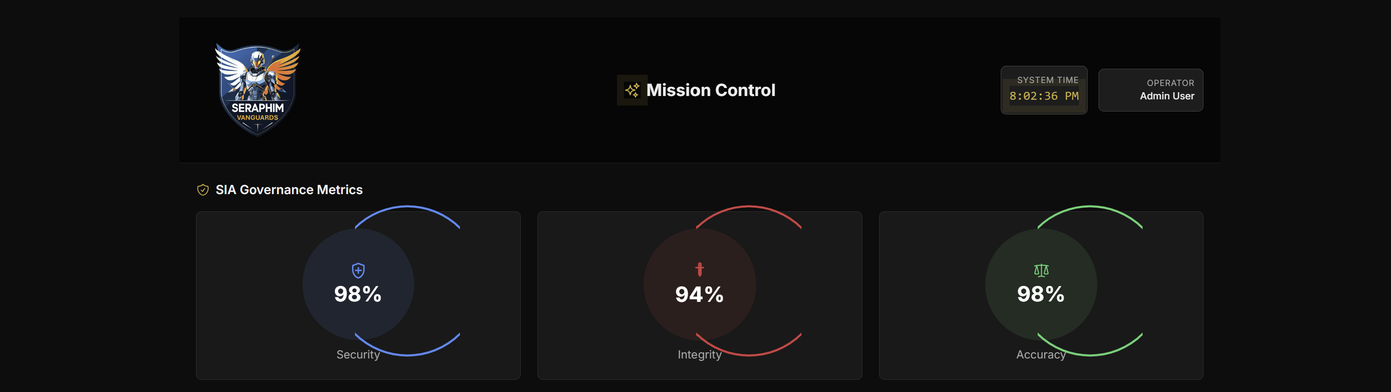
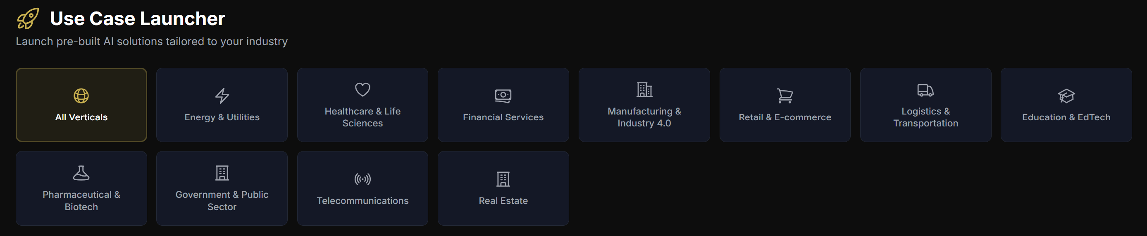
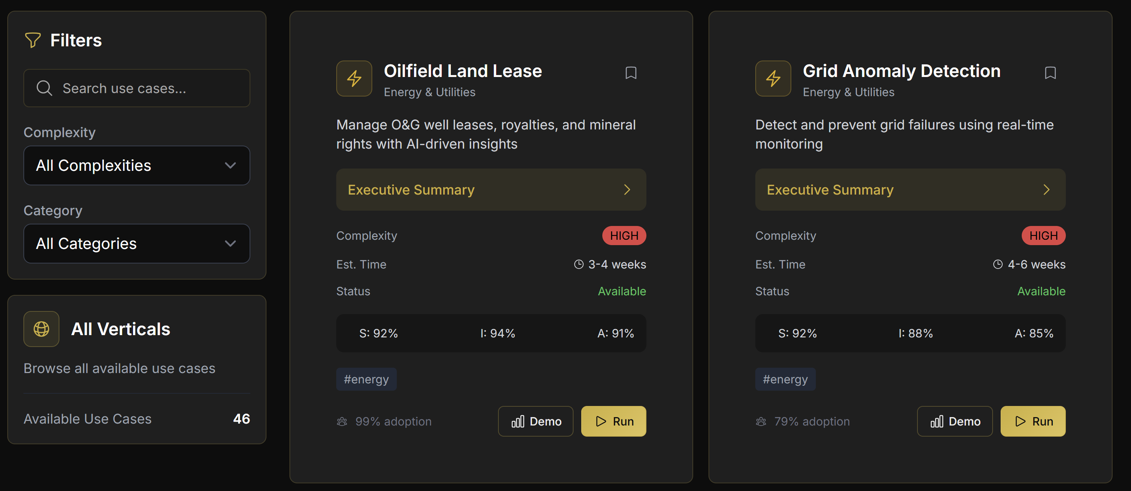
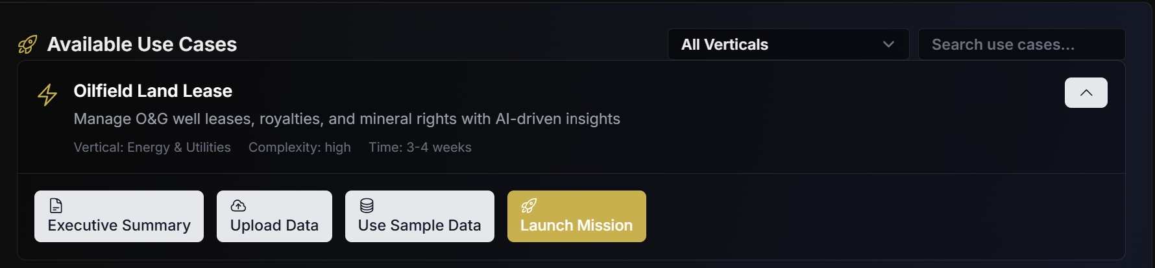
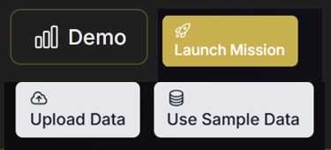
This is the Mission Control Page - - everything for the Vanguards platform is run from here

Slide 3
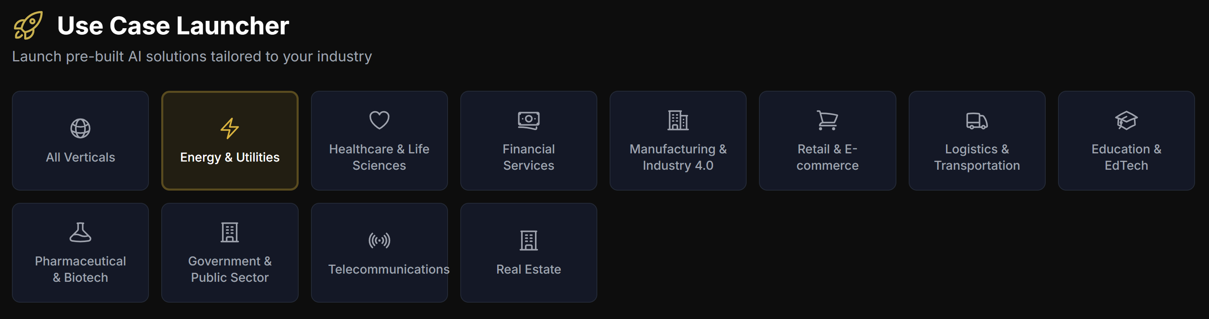
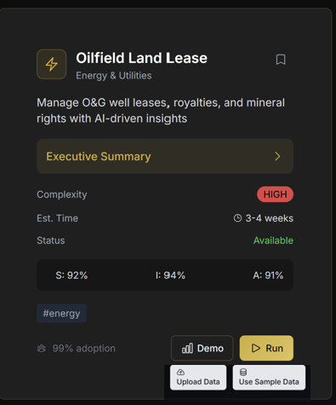
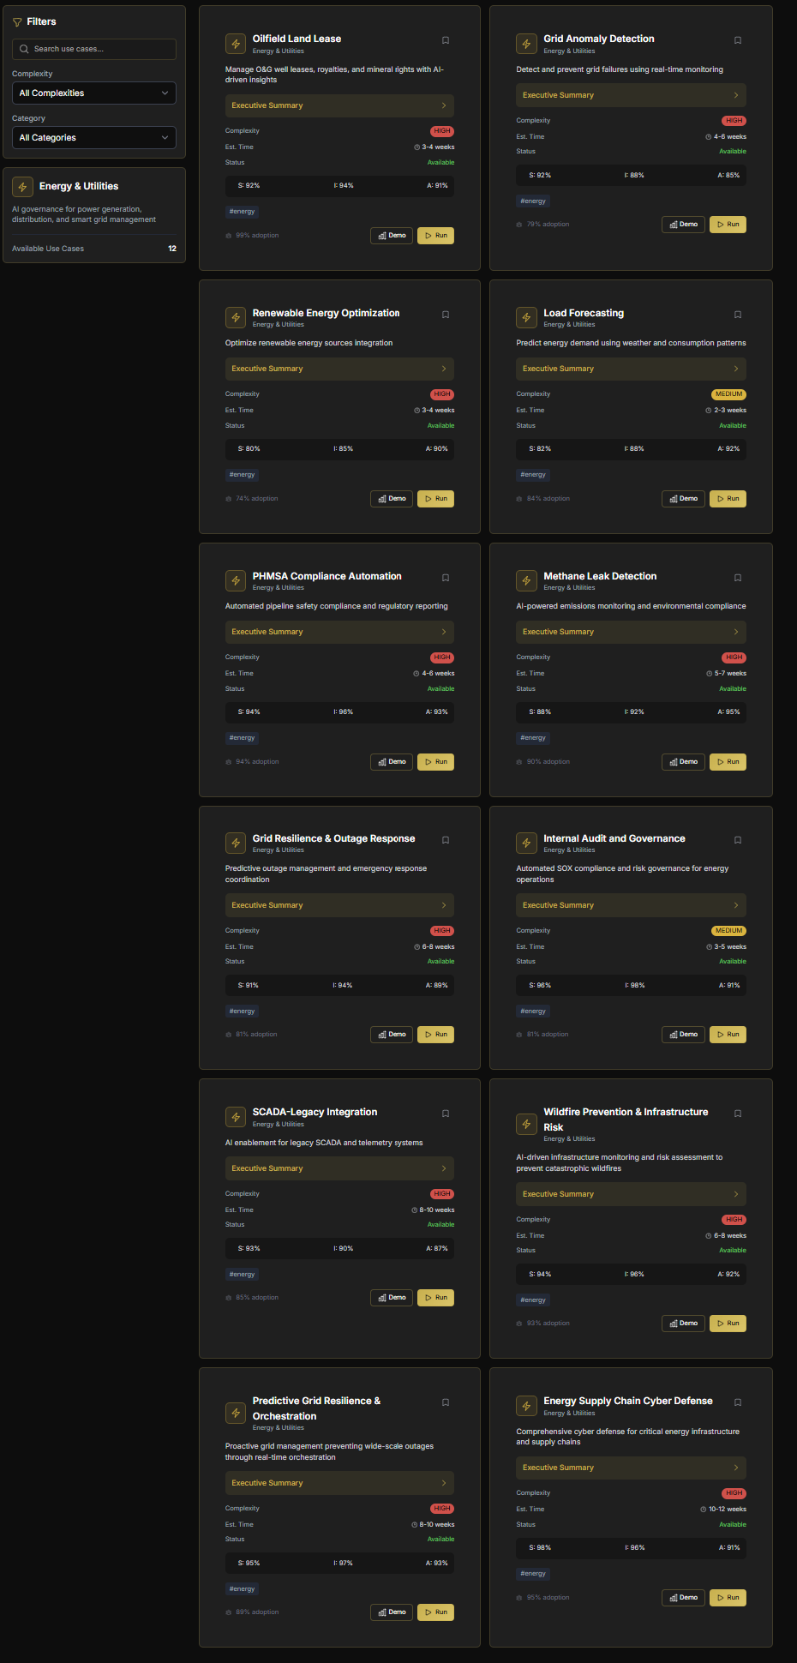
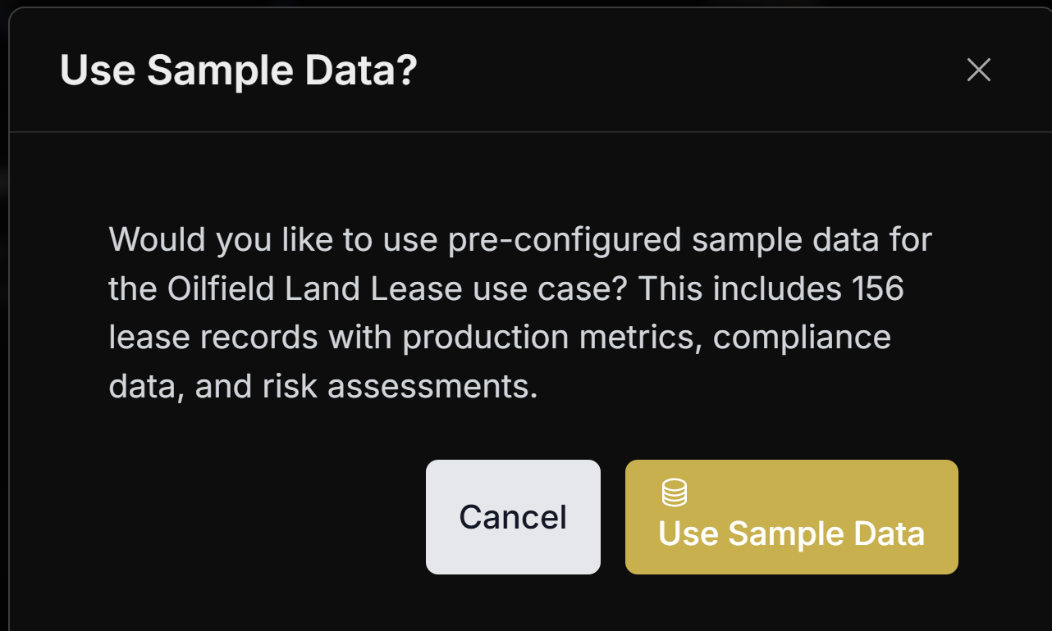
When the user picks a vertical, all the use cases appear and roll down, showing all the use cases in the vertical..
These are the beginning functional buttons for the use case
Here is where the user can run the demo
Upload data to be used
Use the Sample Data for the demo in the mission operation center
Launch the Mission
This button pops up for use sample data and it includes a description of the data

Slide 4
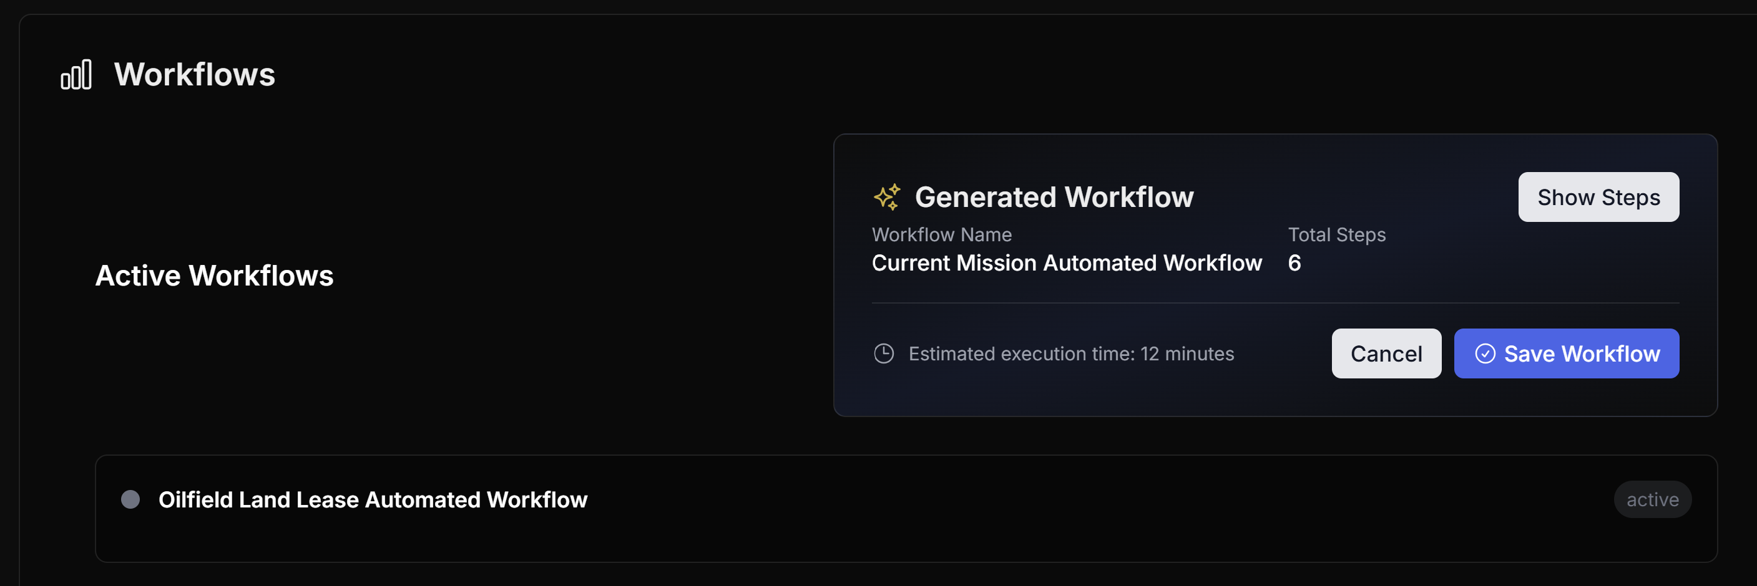
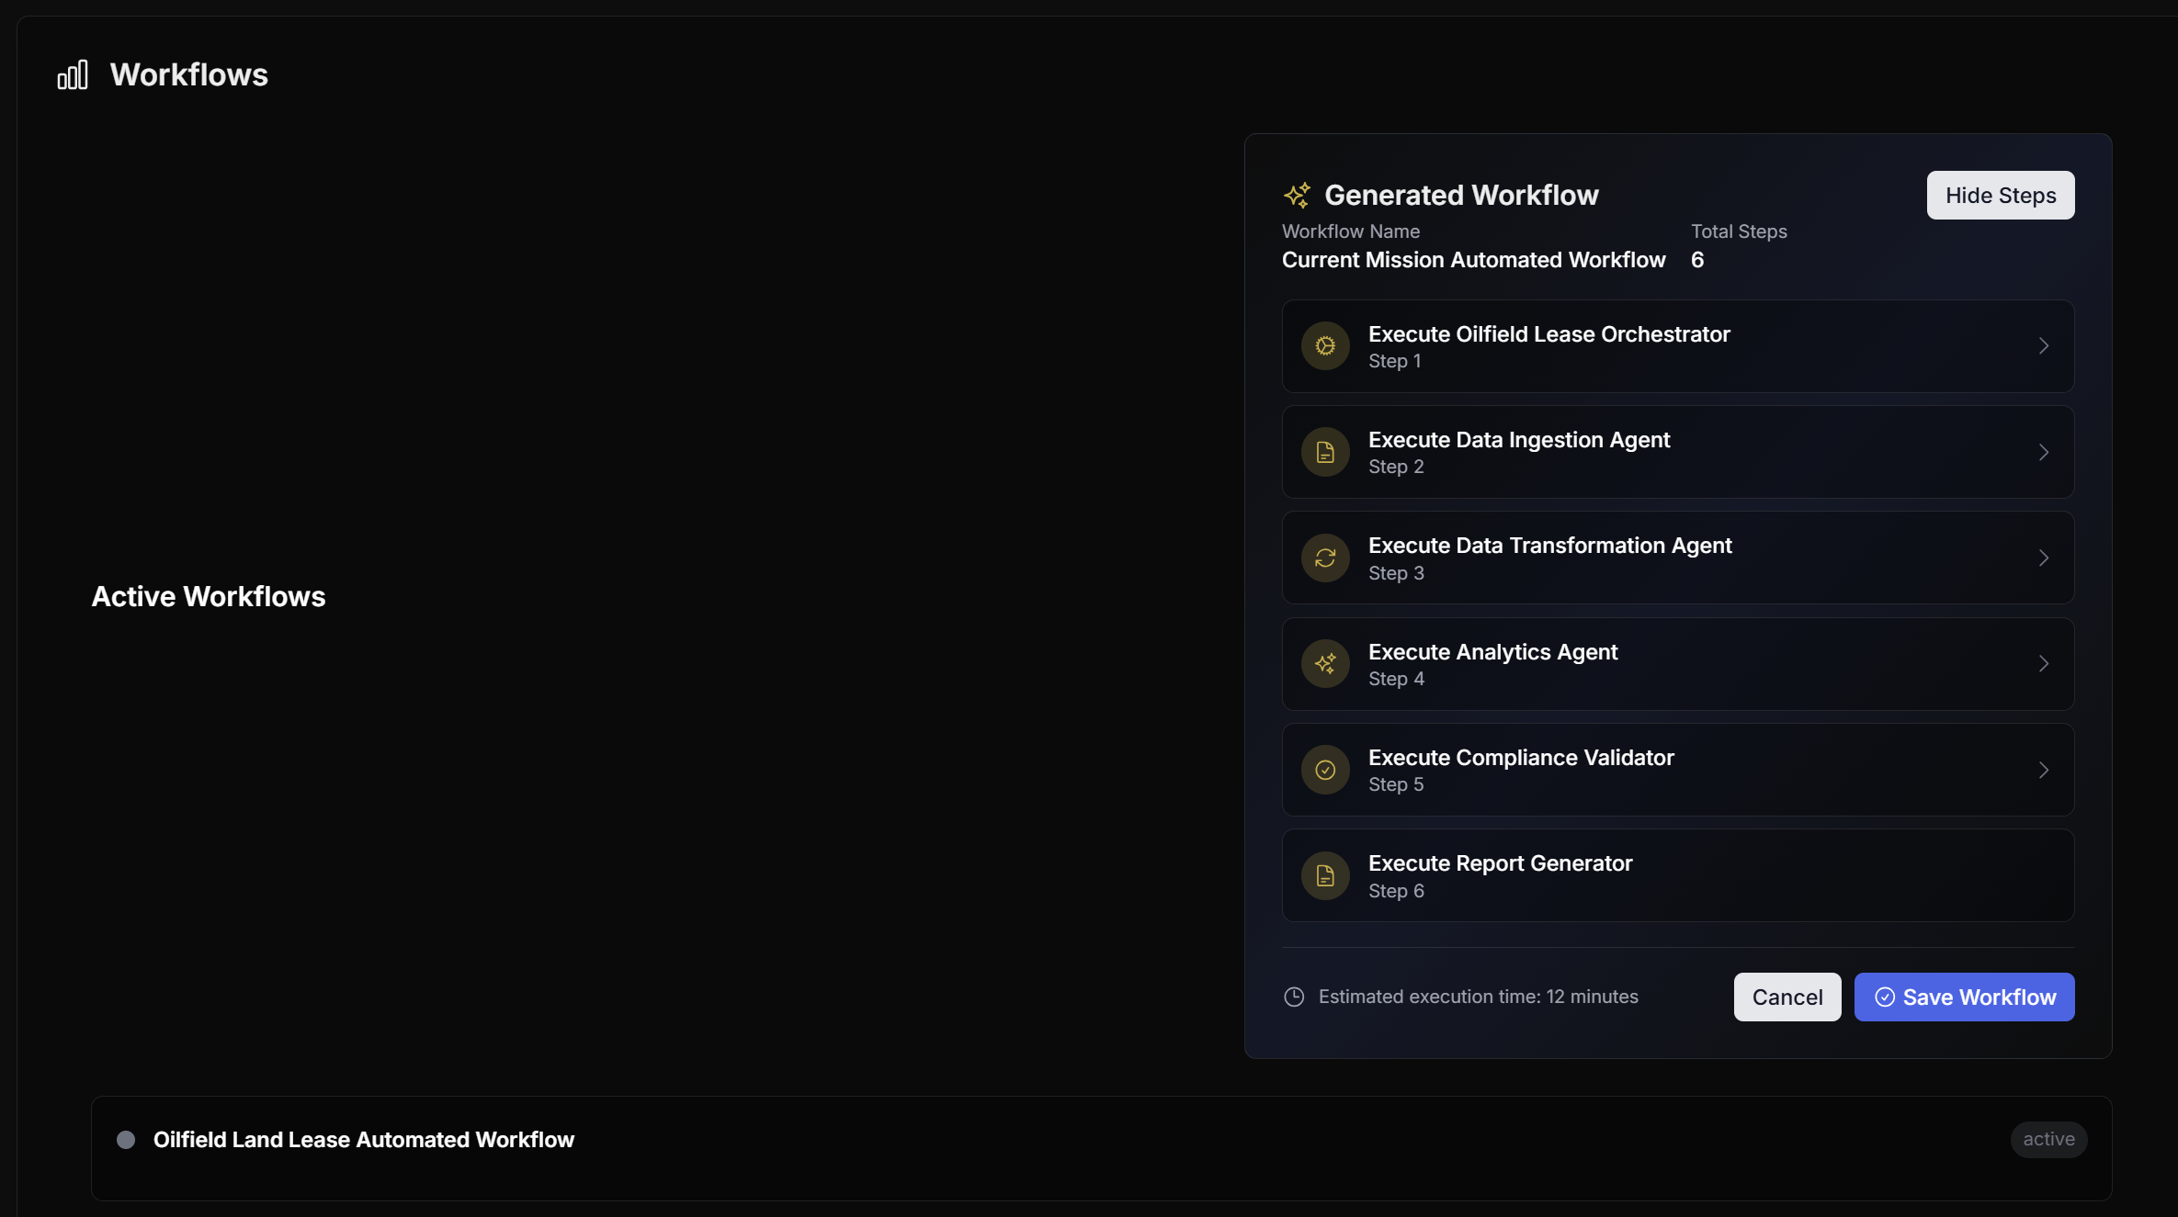
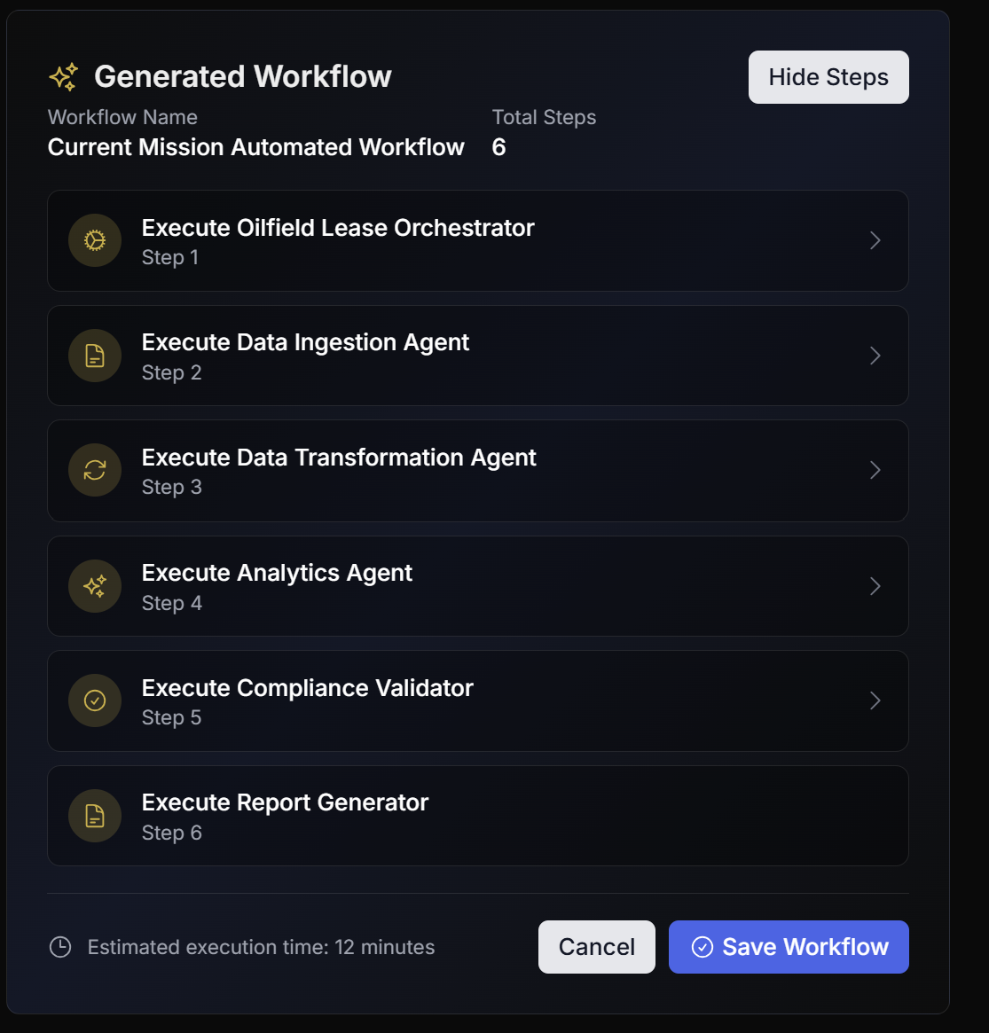

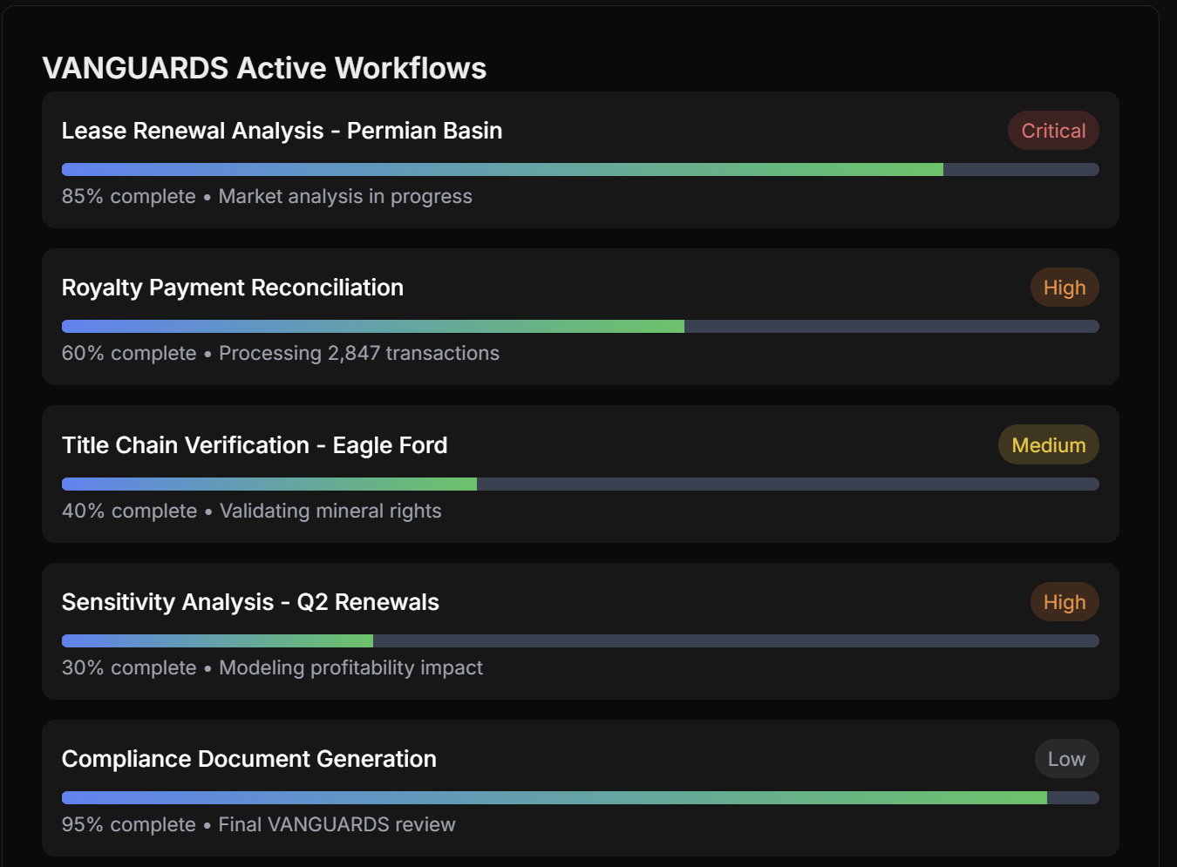
workflows
This should be a breakout place where the user clicks on the workflows and gets a description of what it is along with the agents assigned to it. Each workflow unlocks this part of the screen with details.
*** I am not sure why a workflow should be saved in running a use case since they are preloaded, but please tell me if the button is needed).
These are more granular workflows which should be inside the main ones and viewable as well.

Slide 5
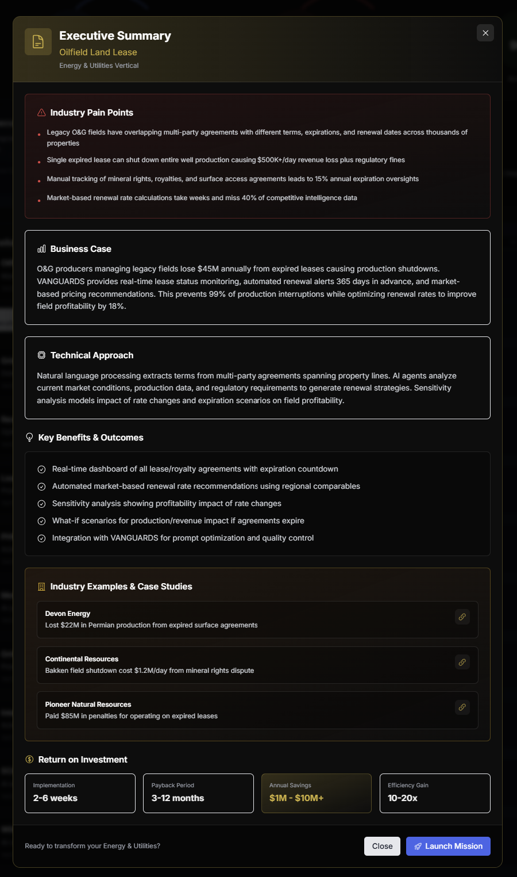
This should be the executive summary for the use case once someone clicks on the executive summary button.
The buttons on the buttom are the same as the ones on the cover of the use case and have the same functionality. However there is a close button as well.
The icon for business case should be a branded color.
The icon for technical approach should be a branded color.
Key benefits & outcomes should be a branded color.
ALL USE CASES SHOULD USE THIS FORMAT.

Slide 6
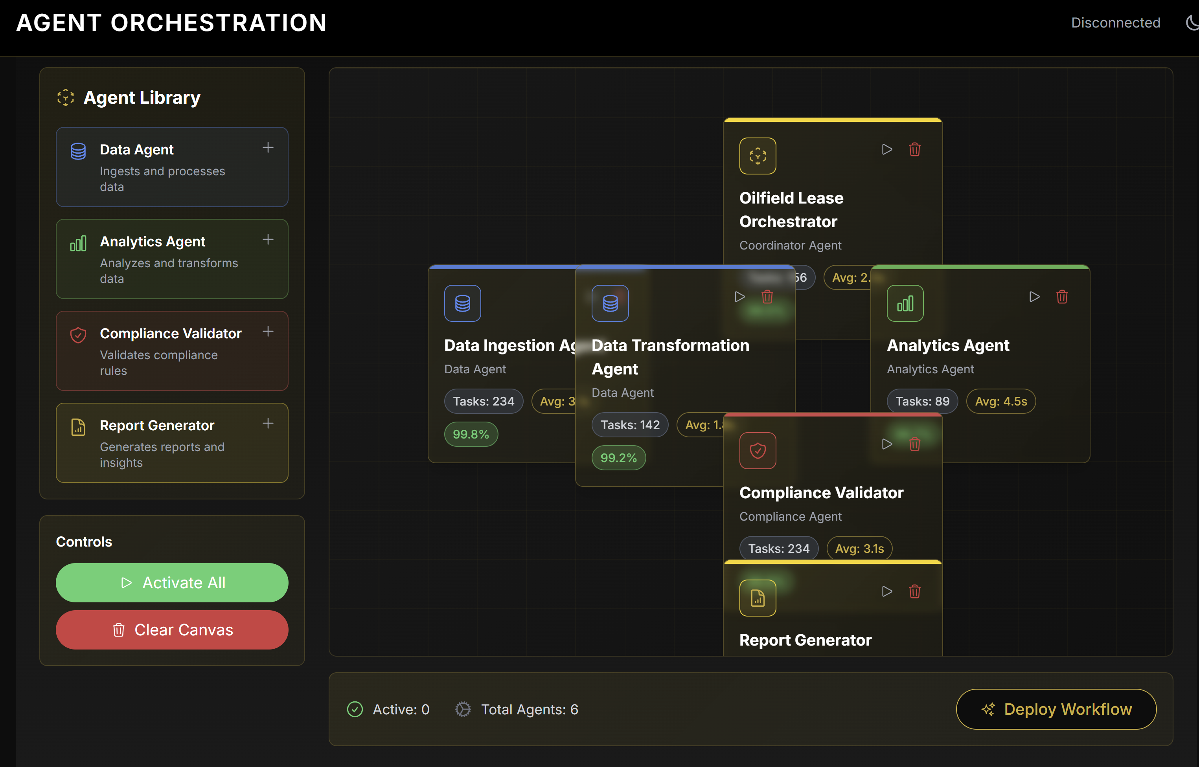

The agents from the preselected use case are automatically loaded onto the space (which was empty before the use case). EACH AGENT IS DRAGGABLE AND MOVABLE.
Nodes and lines of relationships between agents are also available to show any relationships.
Agents should be shown in a structured logical way – spaced out, none overlapping, and all completely visible on the canvas.
When you click on the agent, a screen should open that details ALL of the tasks the agent will perform and the reader can scroll down and read basic details of the task).
When you click activate all – the button will then turn gold and say “Activated”

Slide 7
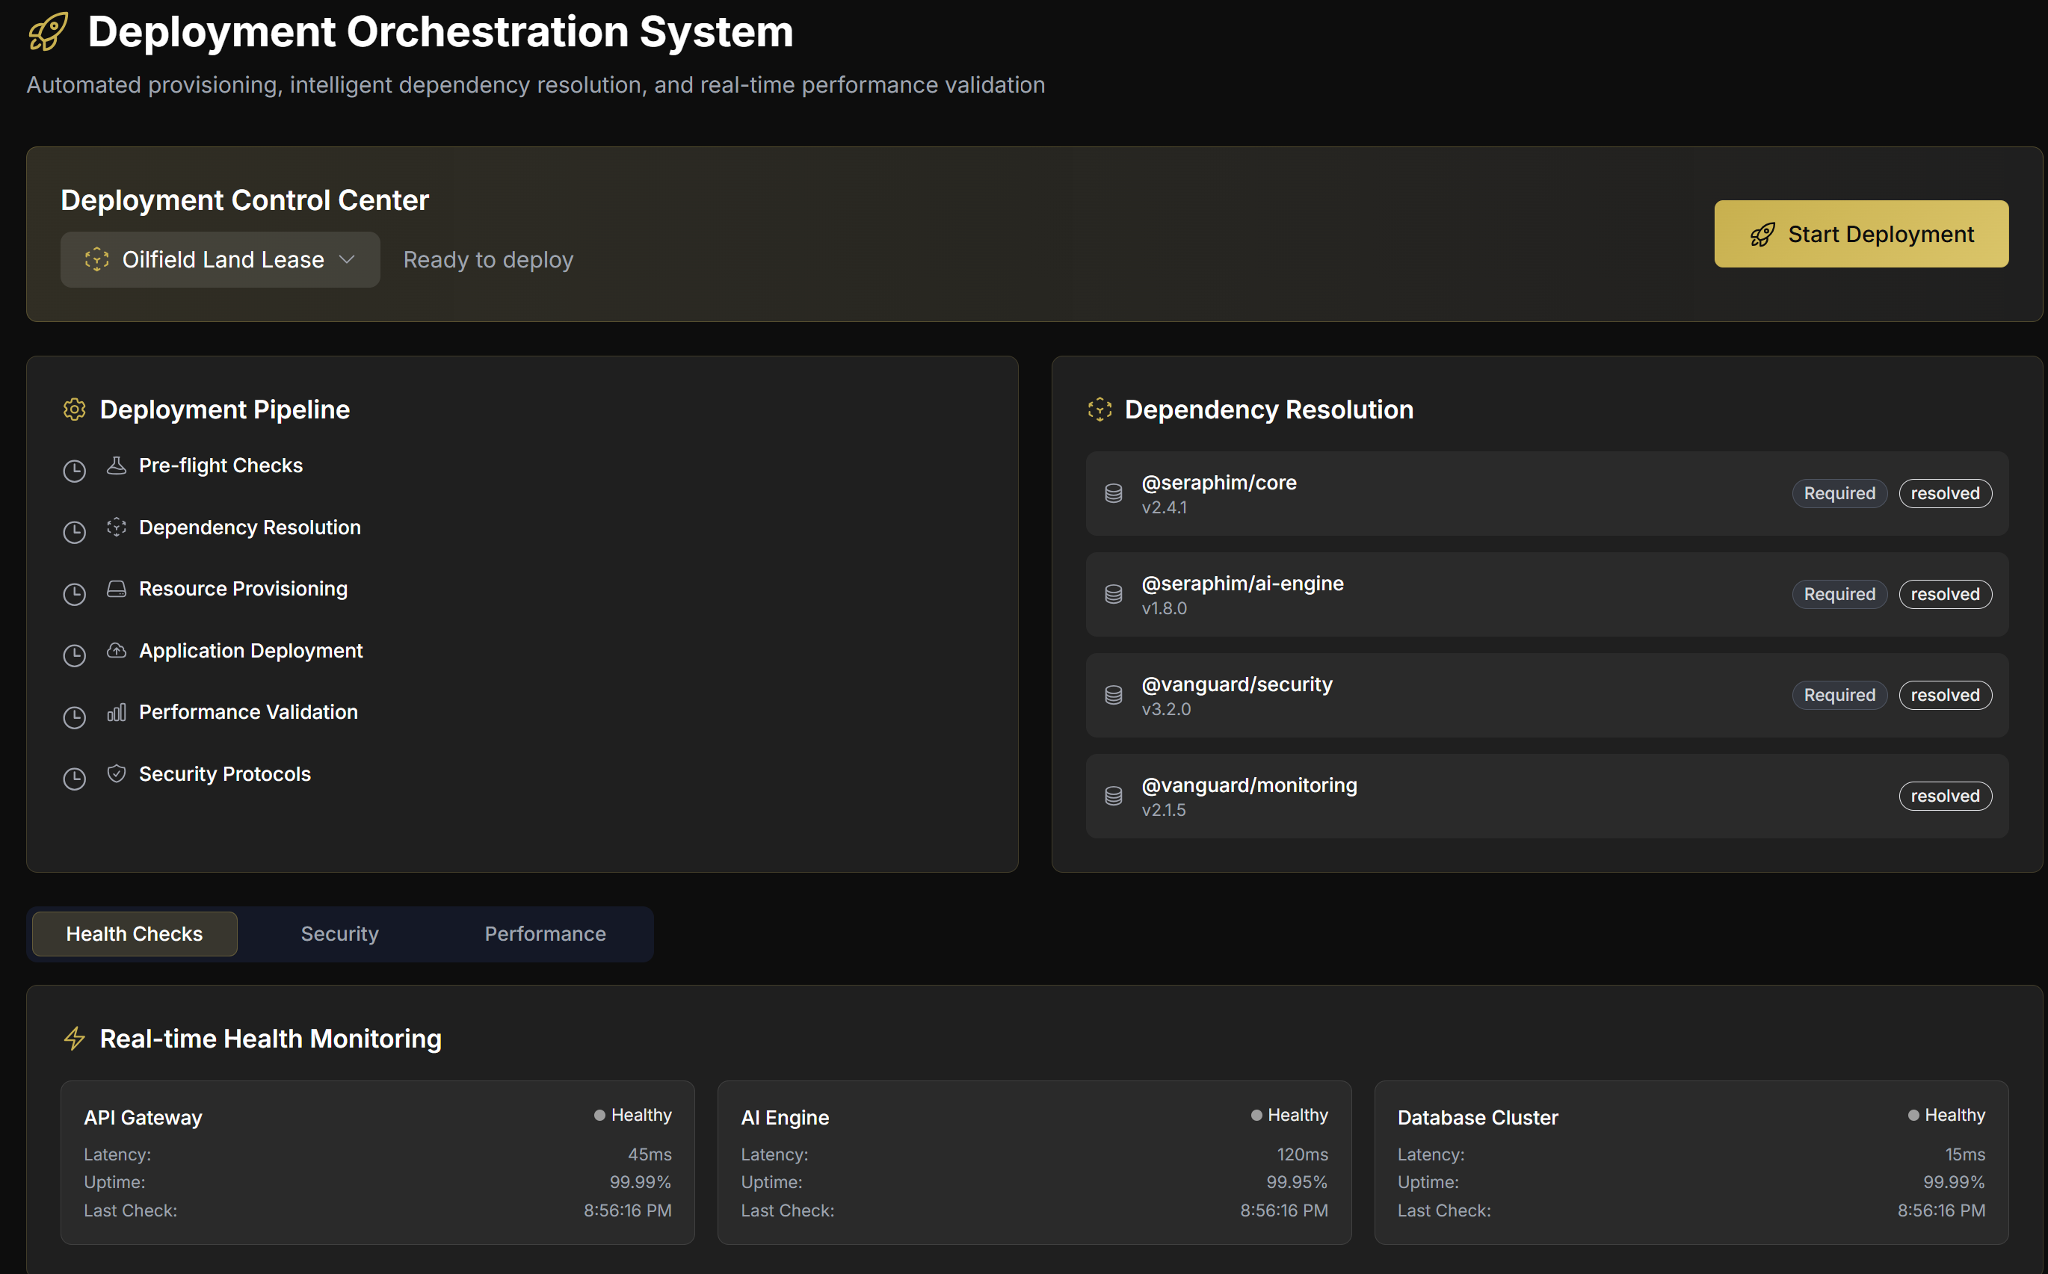
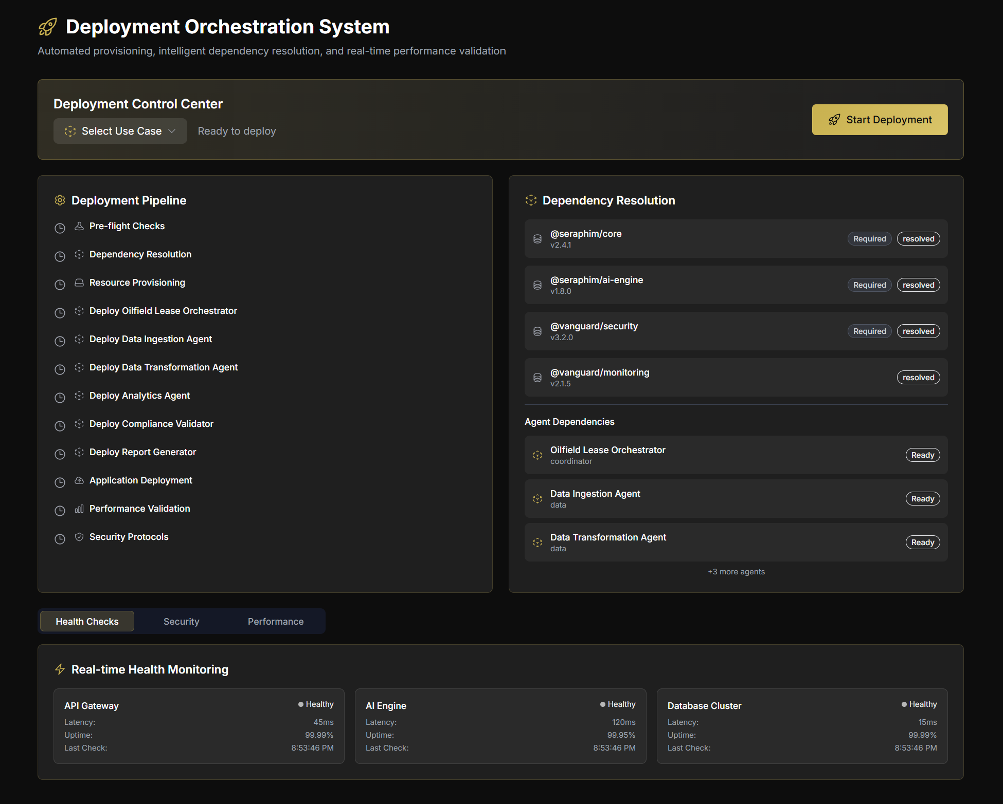
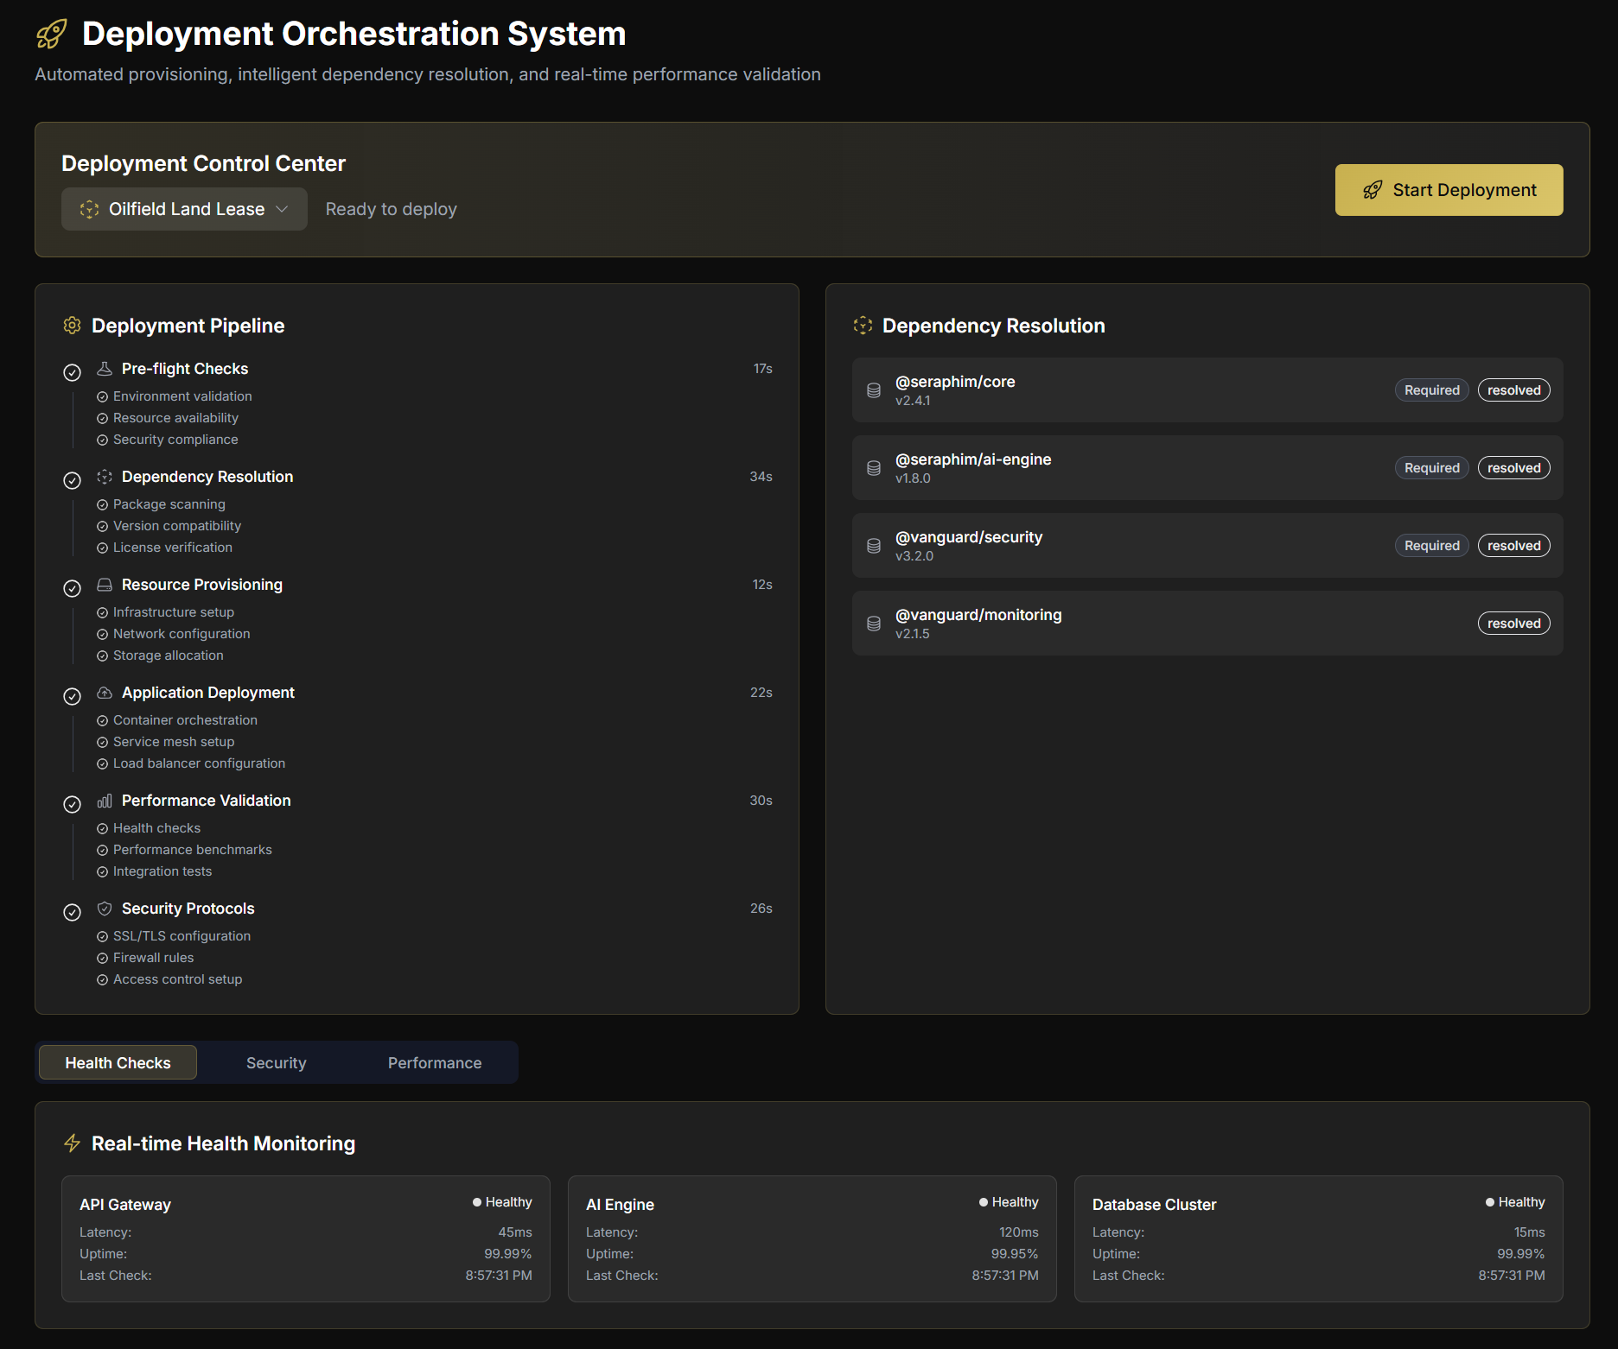
The entire deployment section starts and runs

Slide 8
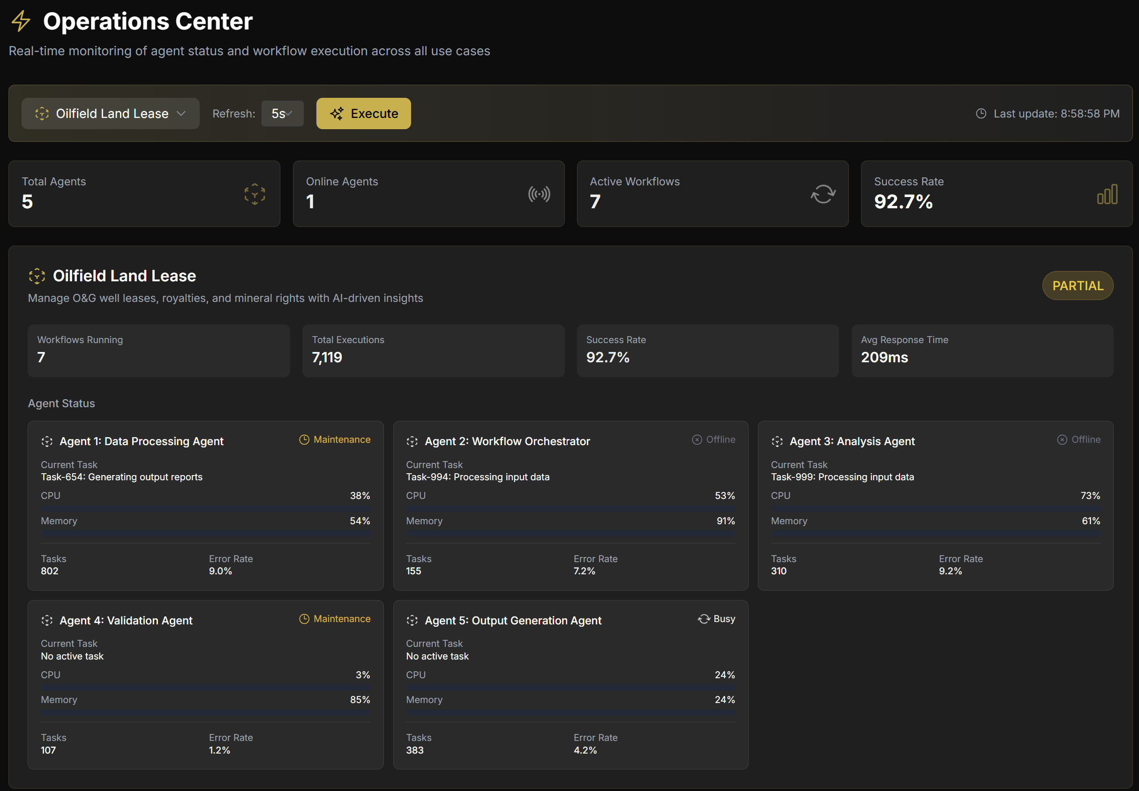
Operations are executed and ran
Users can monitor the behavior of agents.

Slide 9
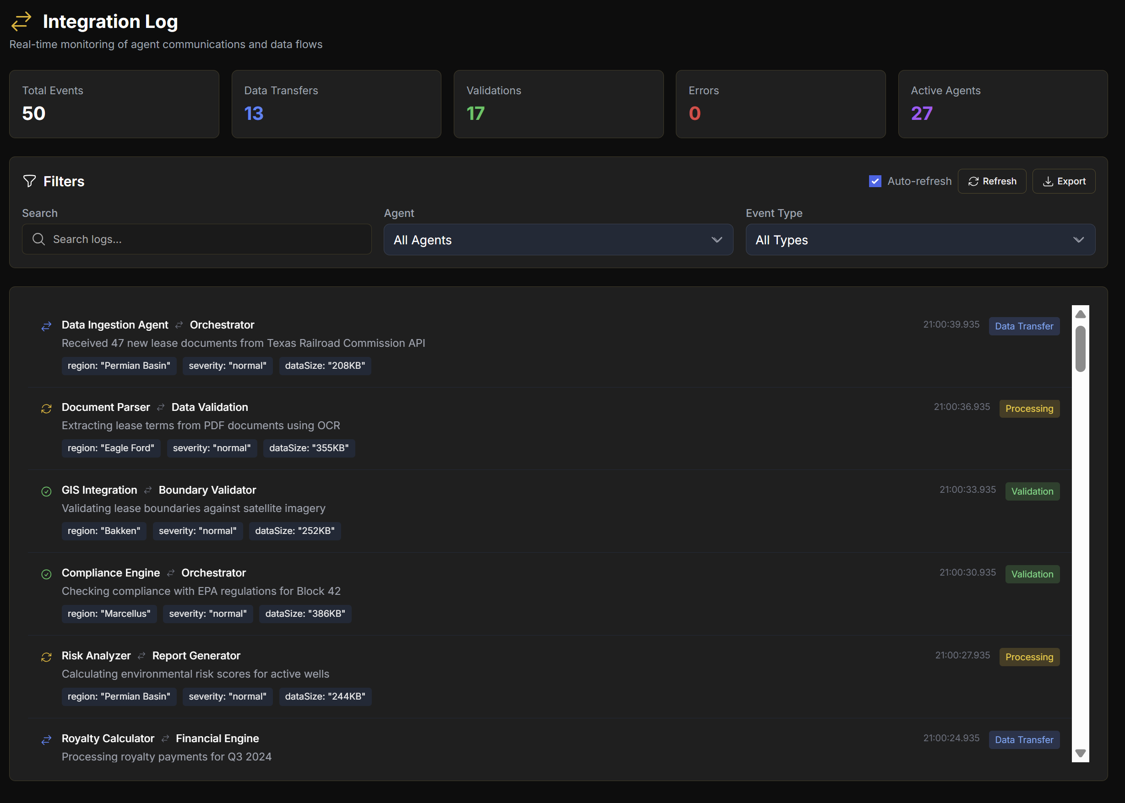
Integration logs tracking everything

Slide 10
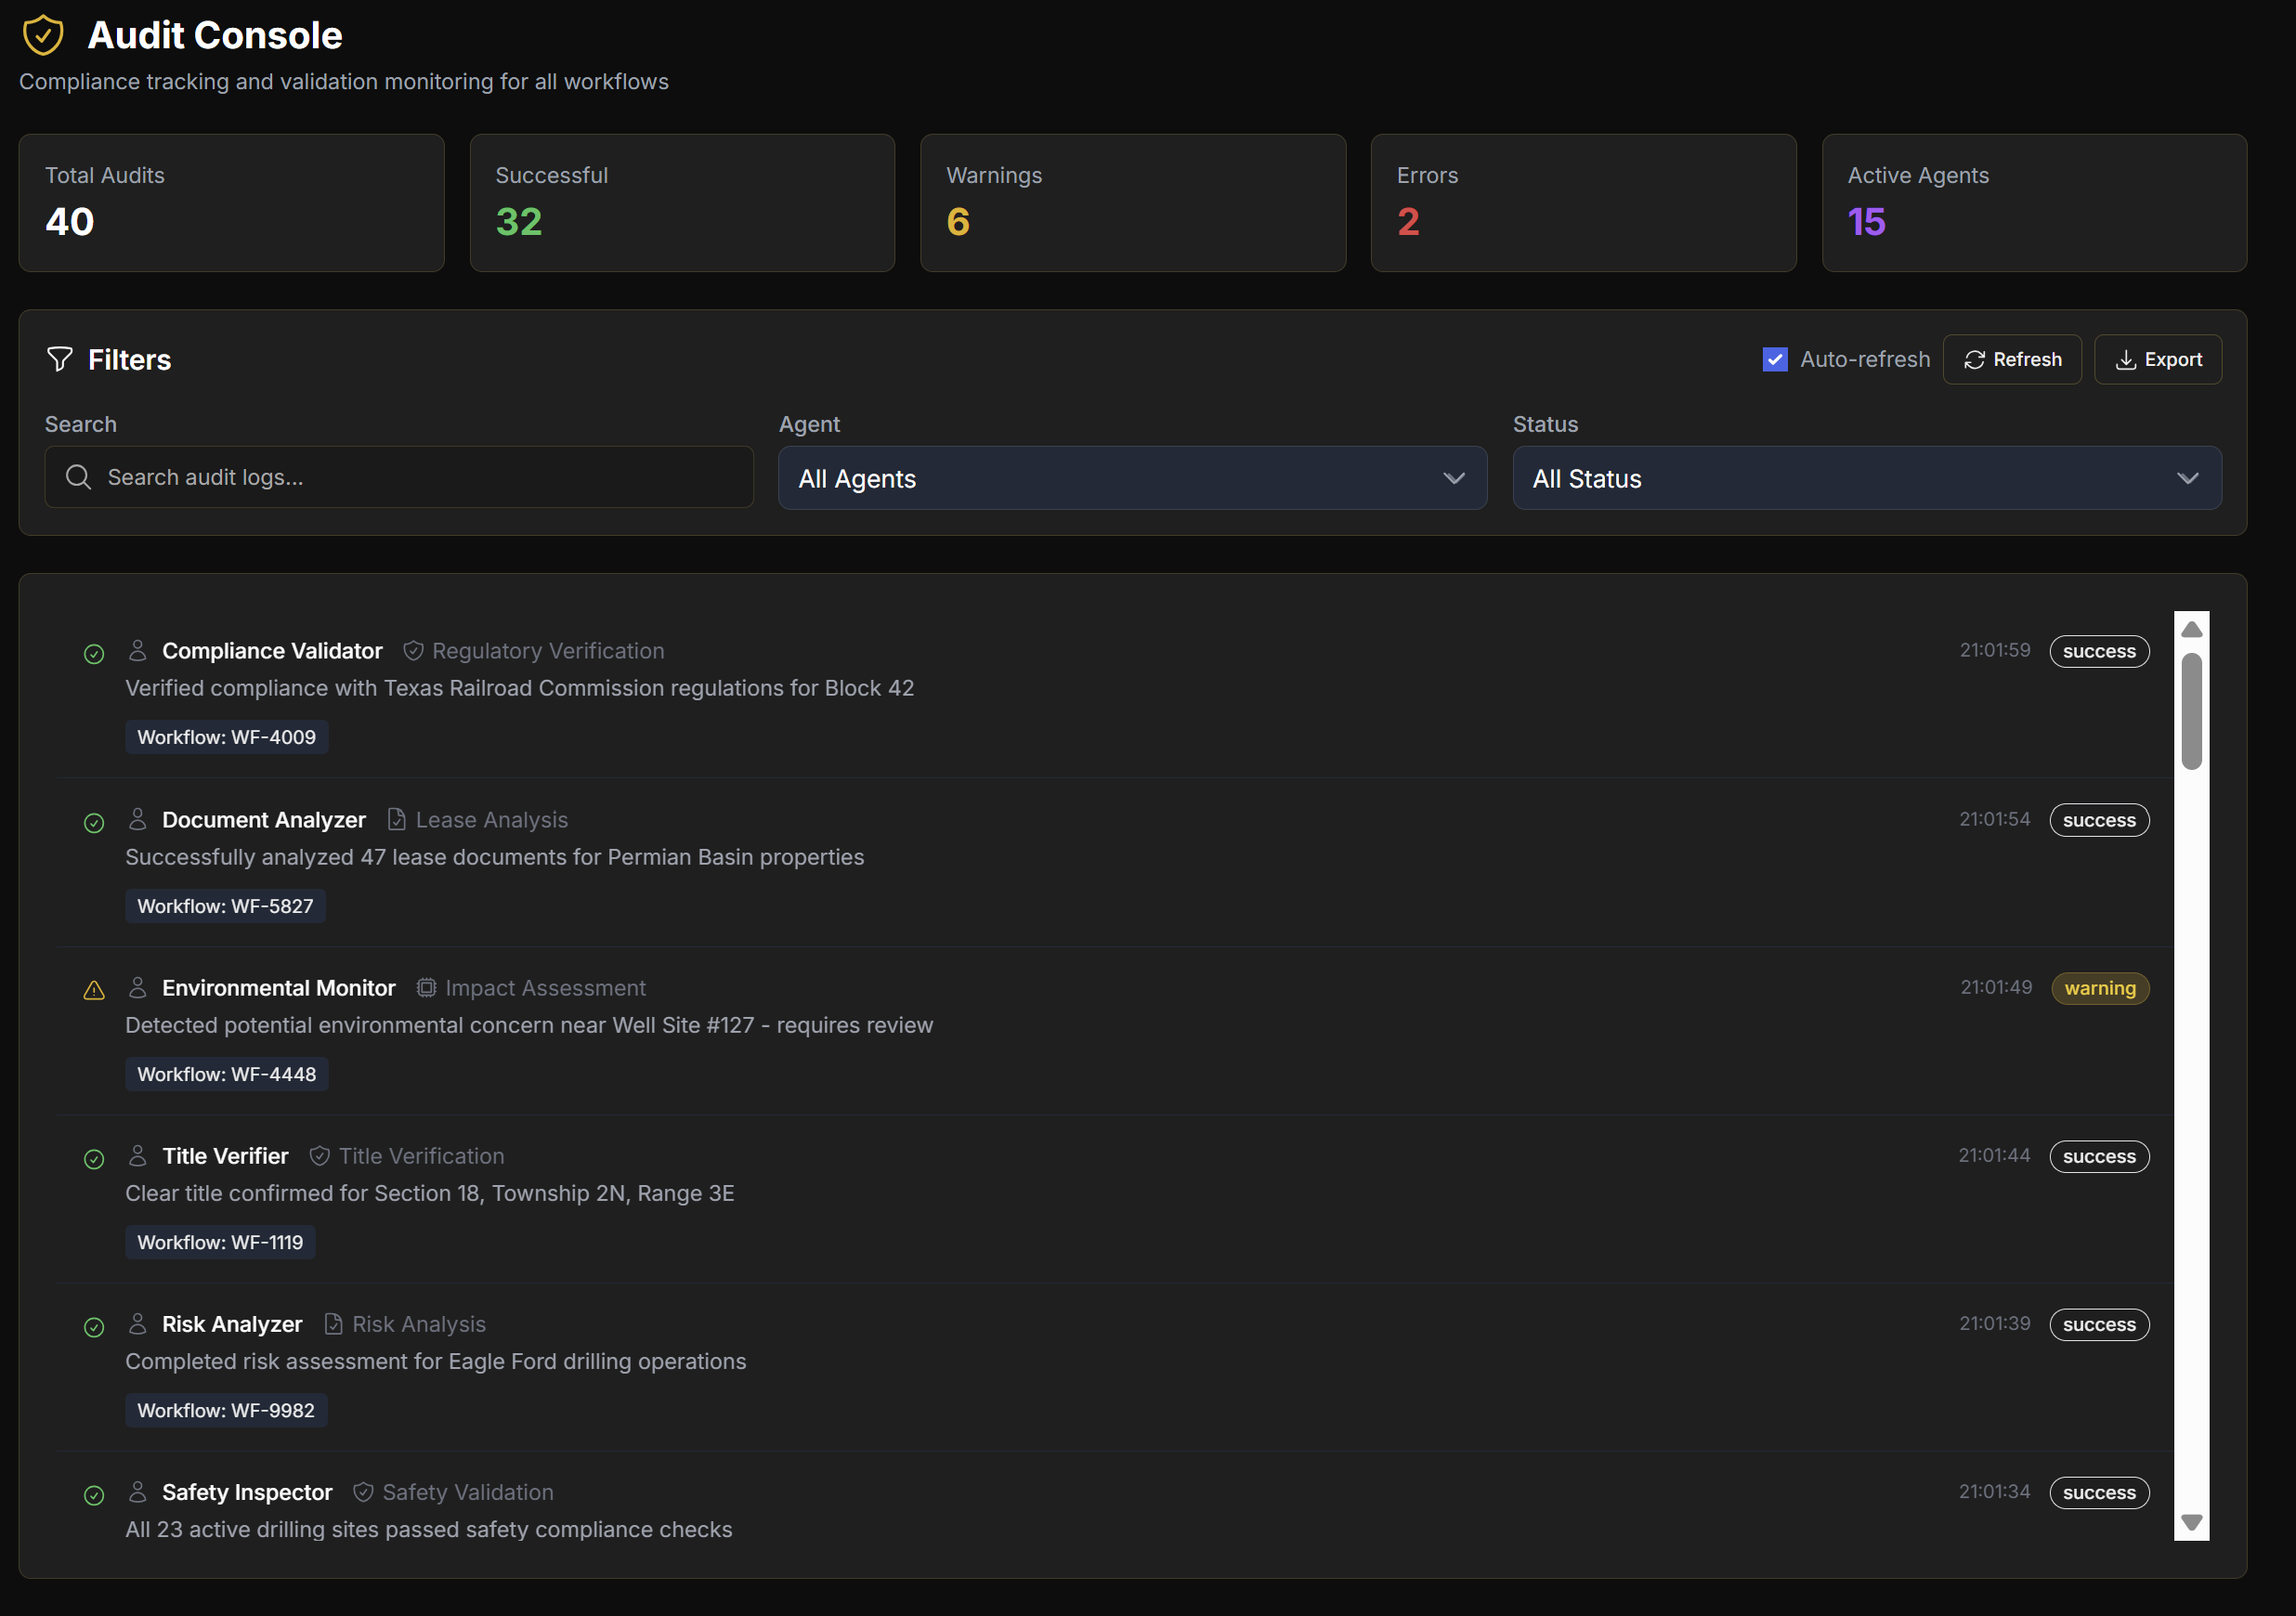

Slide 11
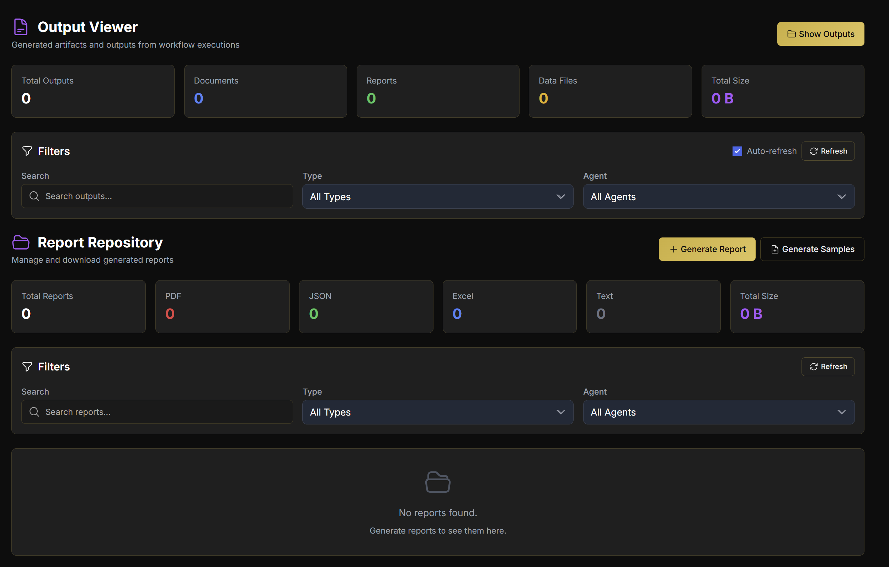
This should be filled with downloadable reports and pdf files and csv and xslx and json files. There should also be an organized repository.

Slide 13
Use Case Dashboard Tab
This is a new dashboard we are going to make in lieu of the Mission Operations Center

Slide 14
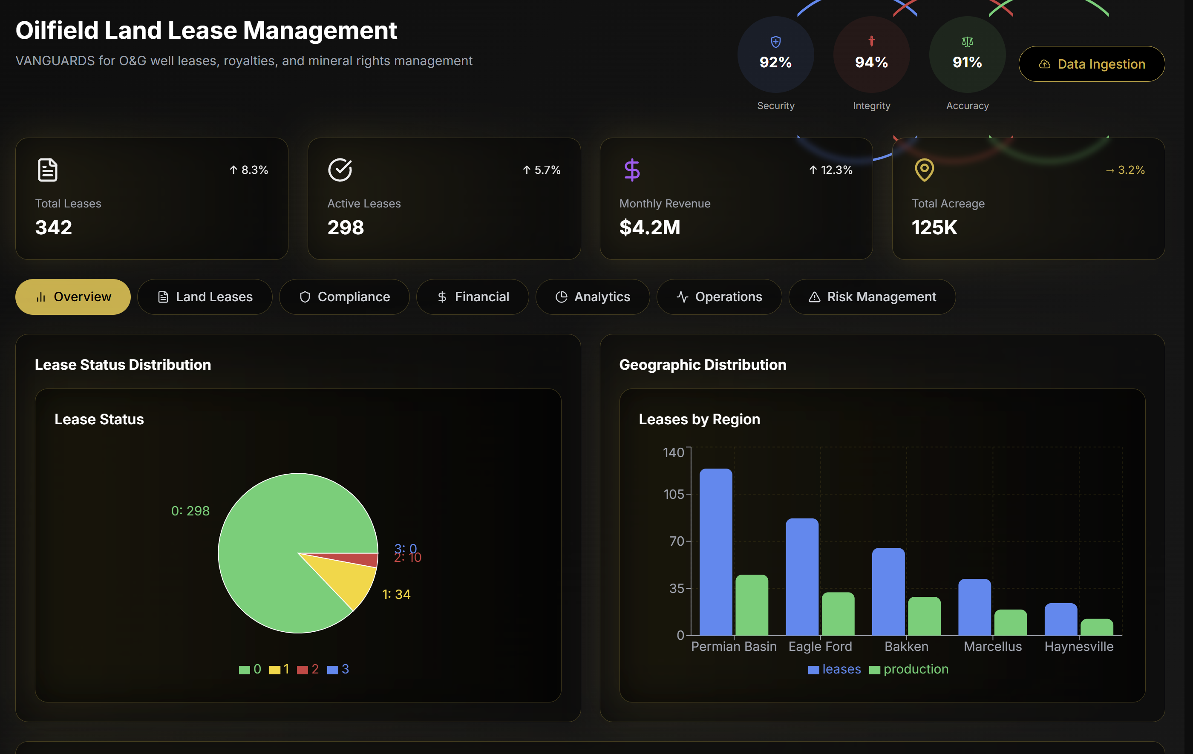

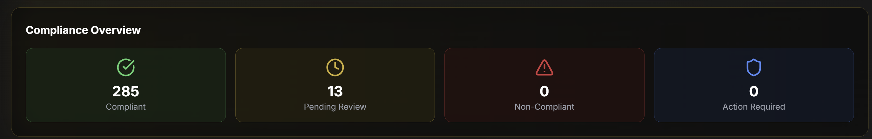
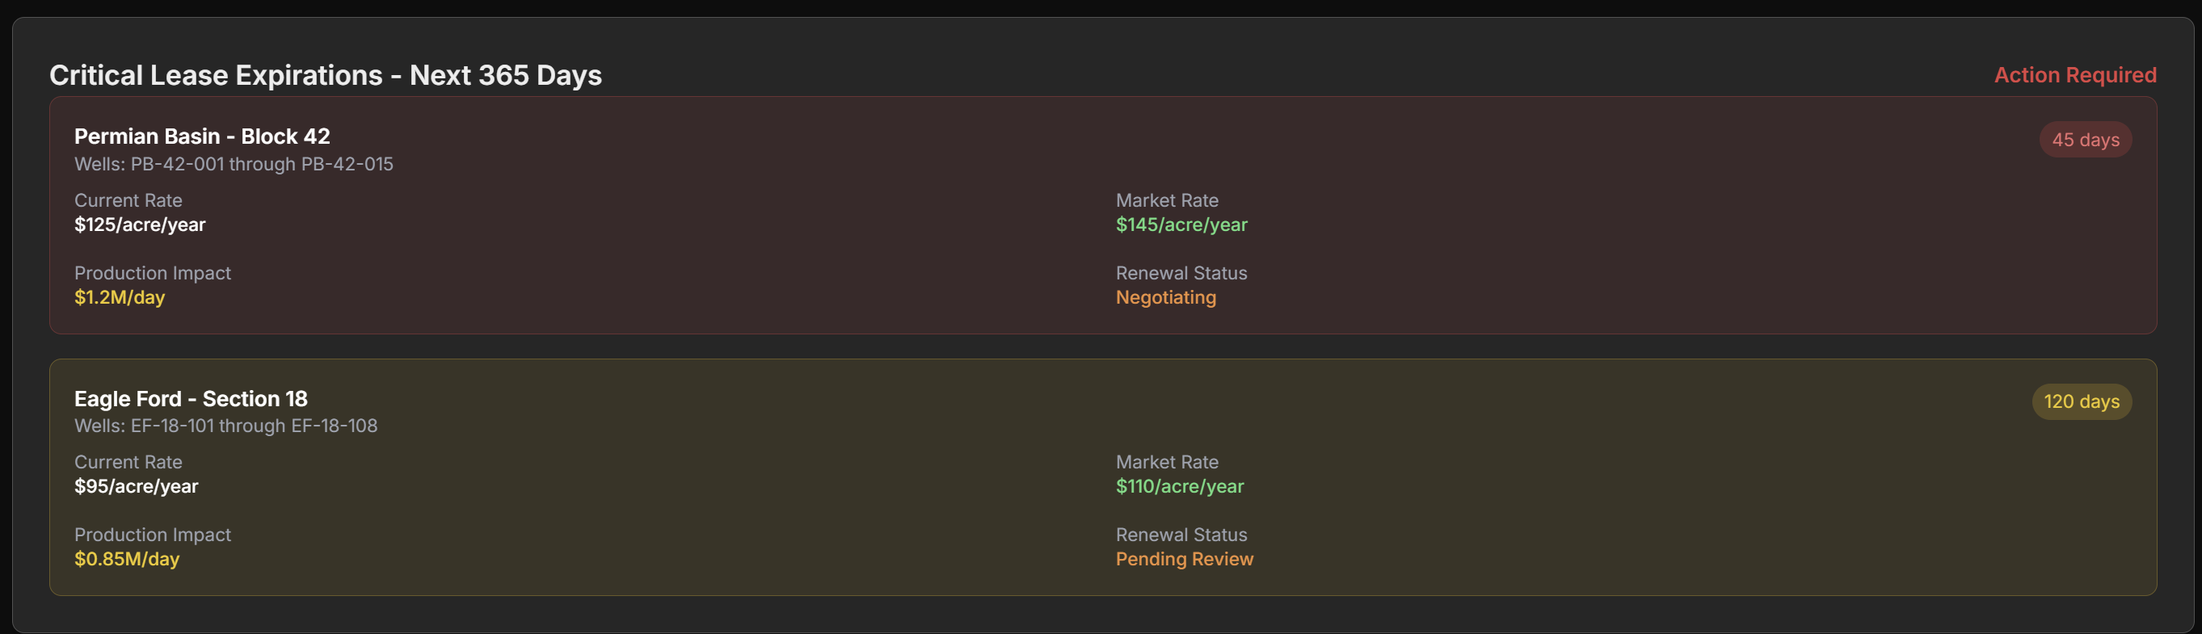
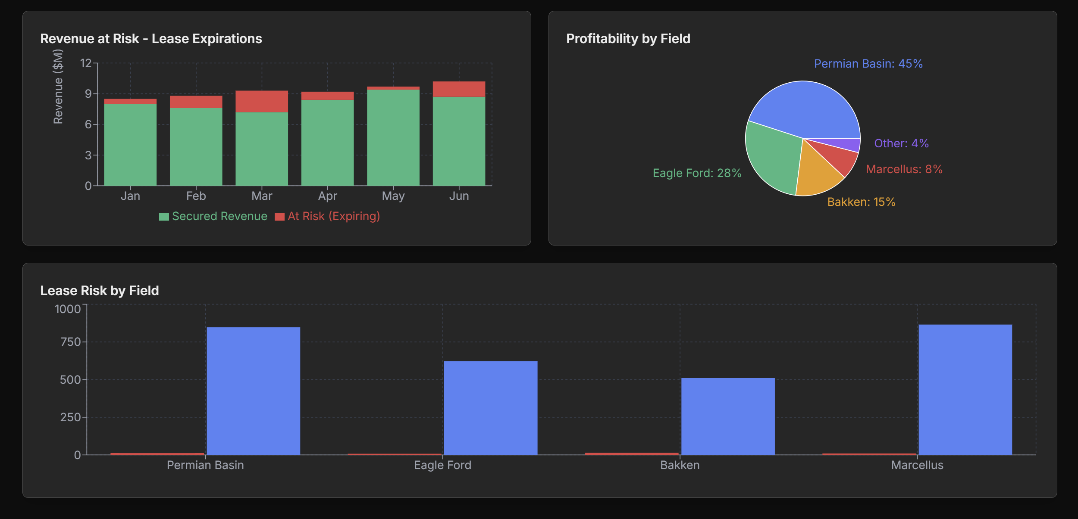

Slide 15
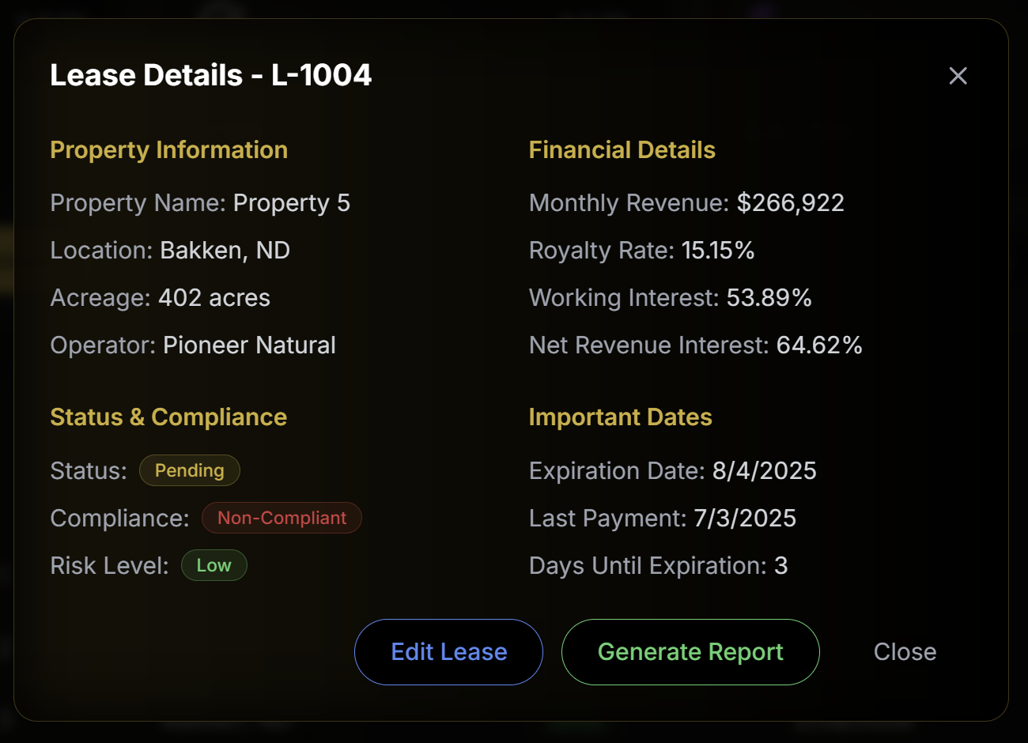
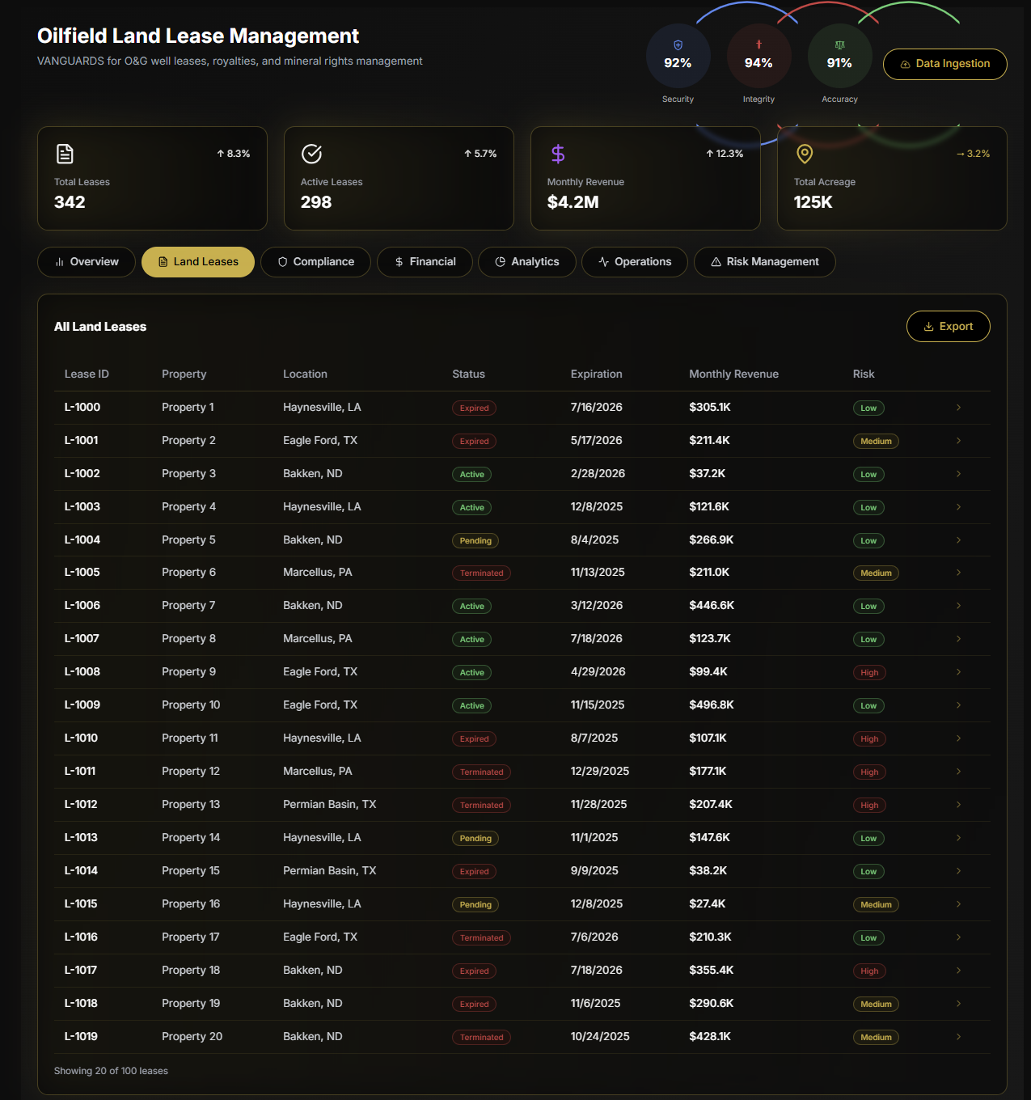
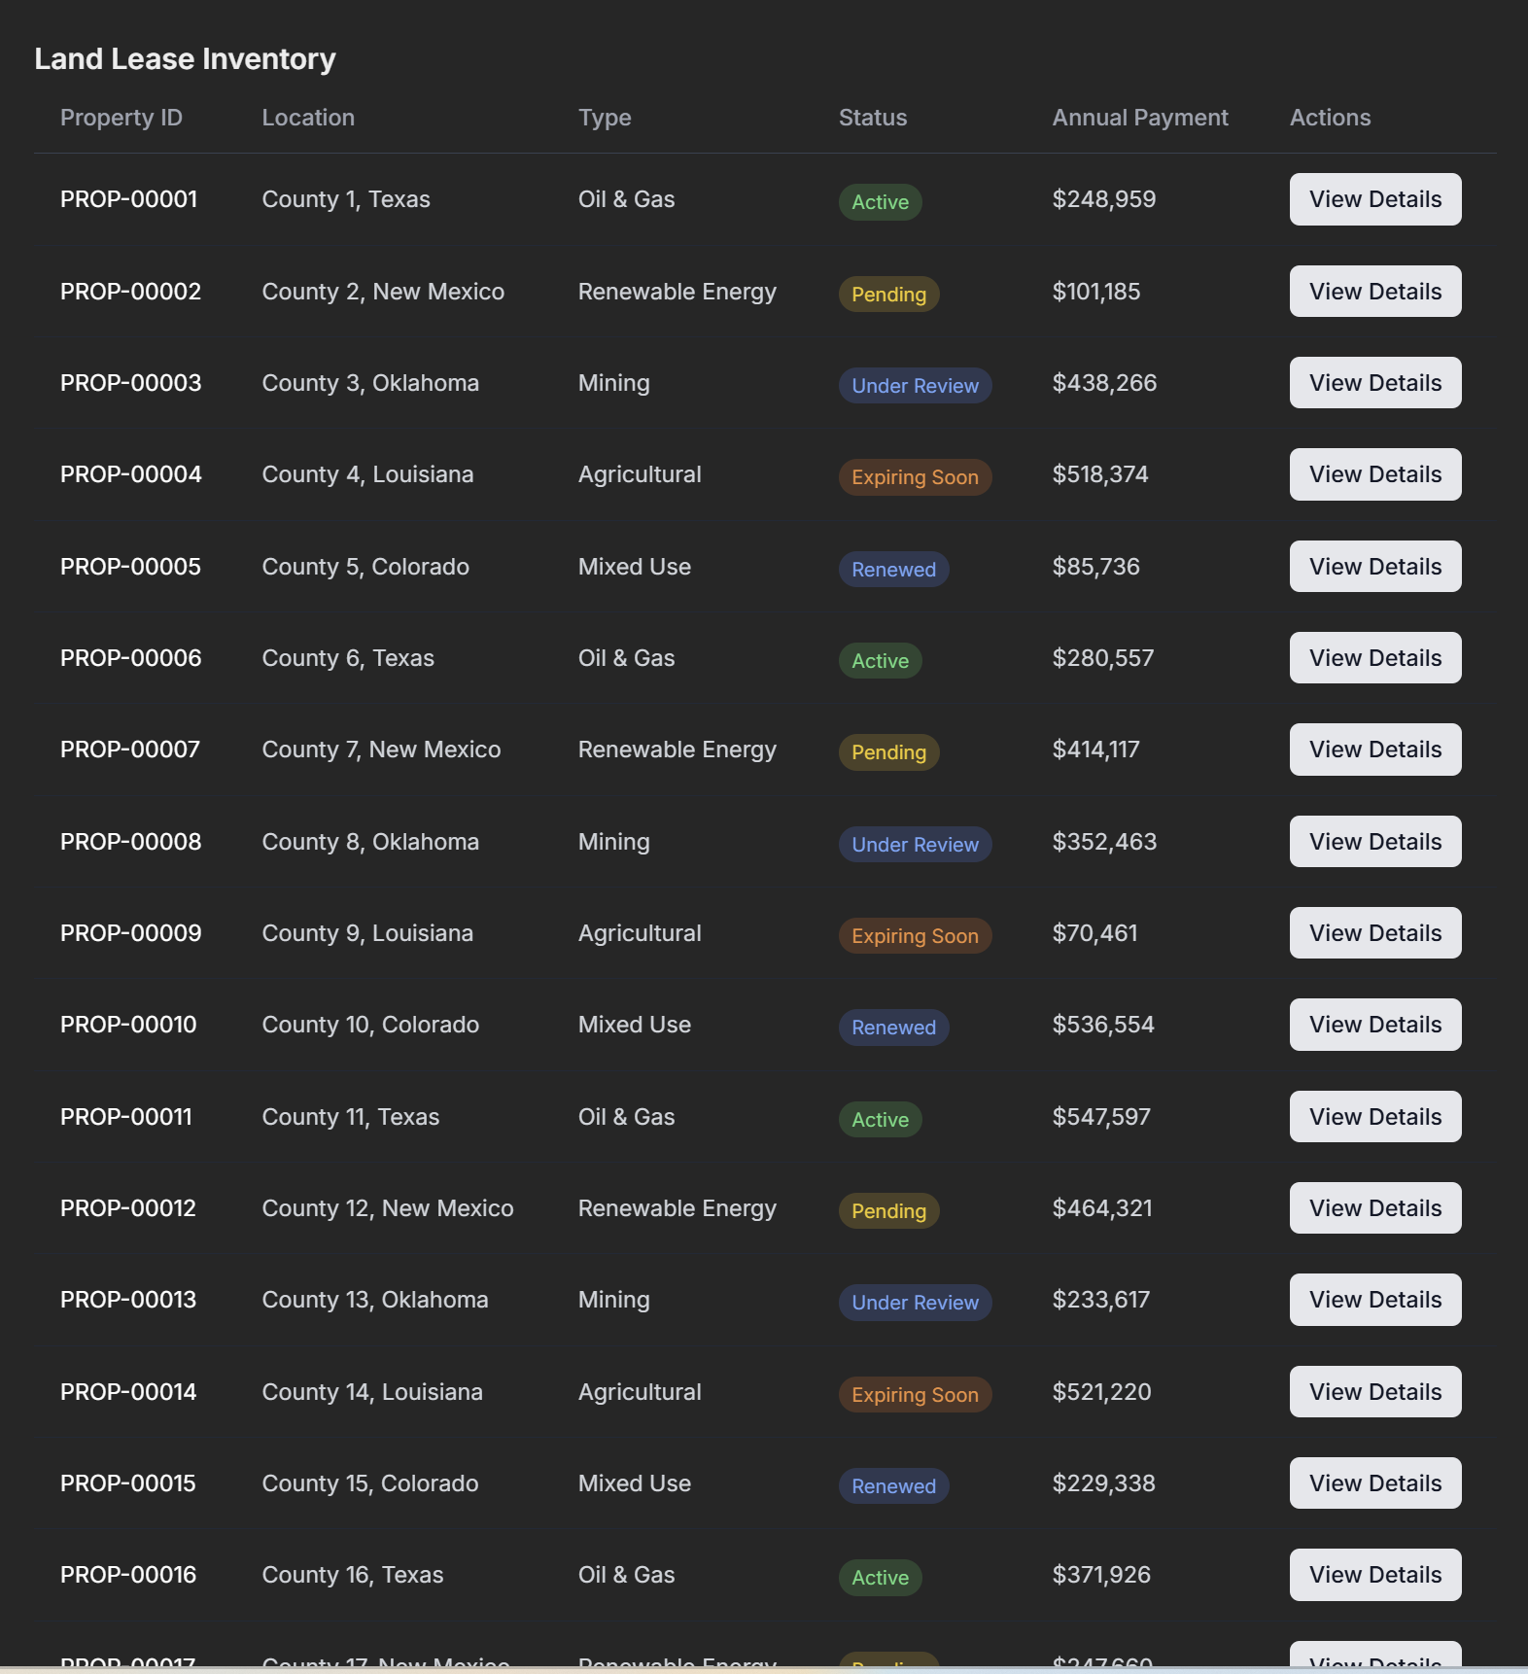
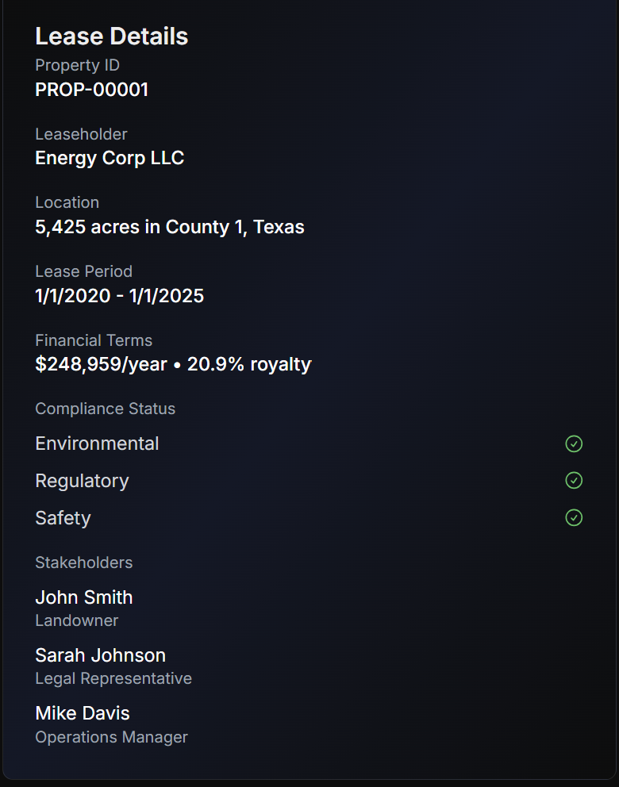
Statuses should be either
Active
Under Review
Pending
Expiring Soon
Expired
Terminated
ALL of these lease details should be on ONE lease Details Popup. Organize in a great way.

Slide 16
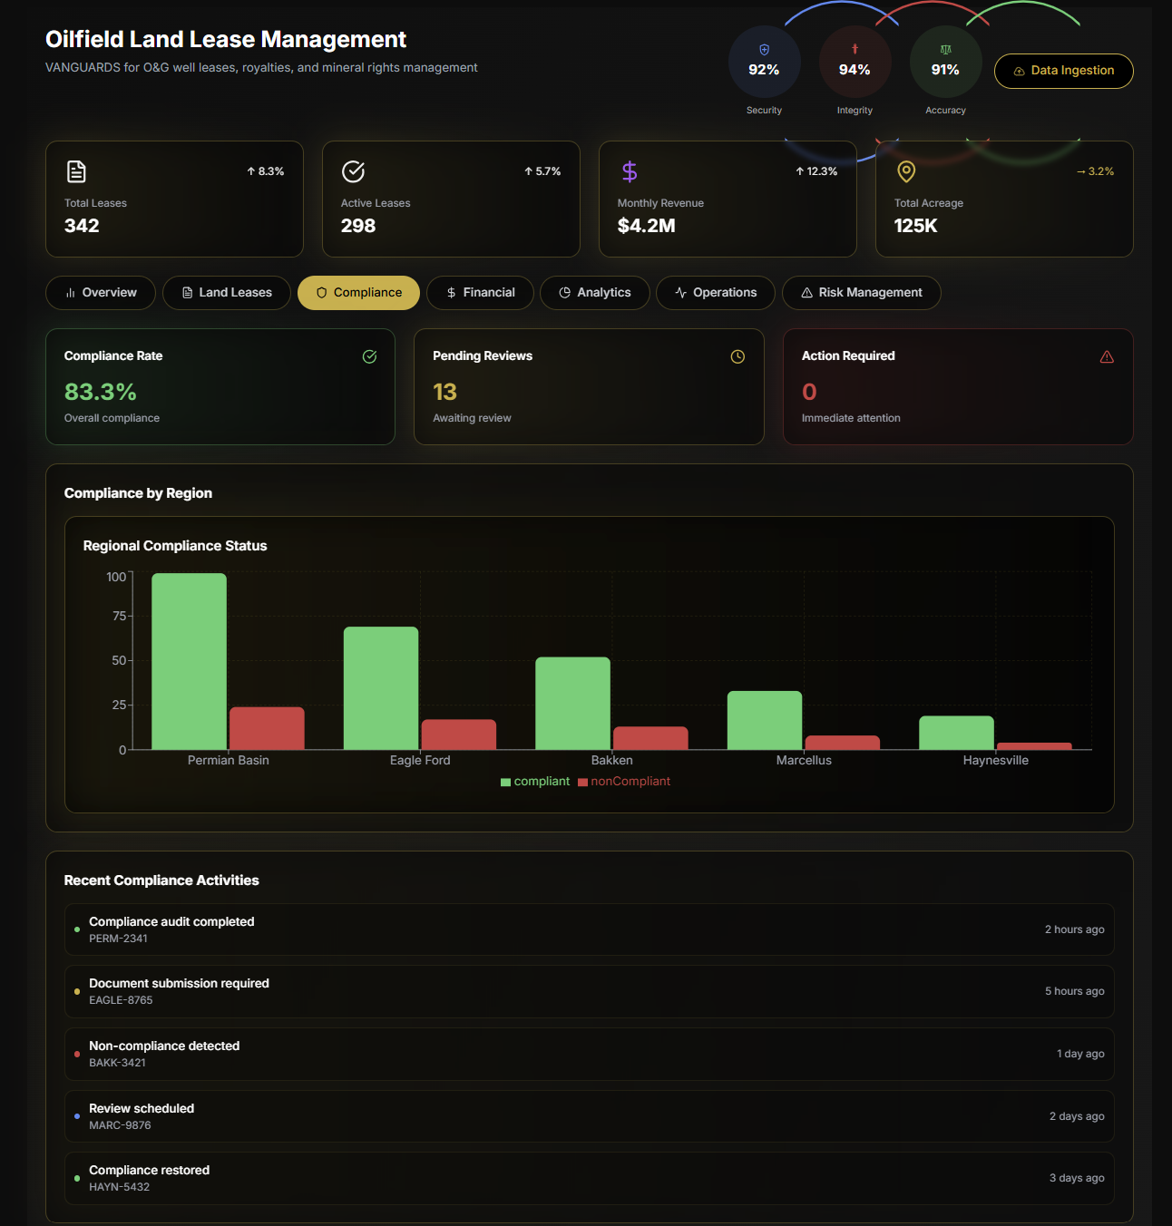
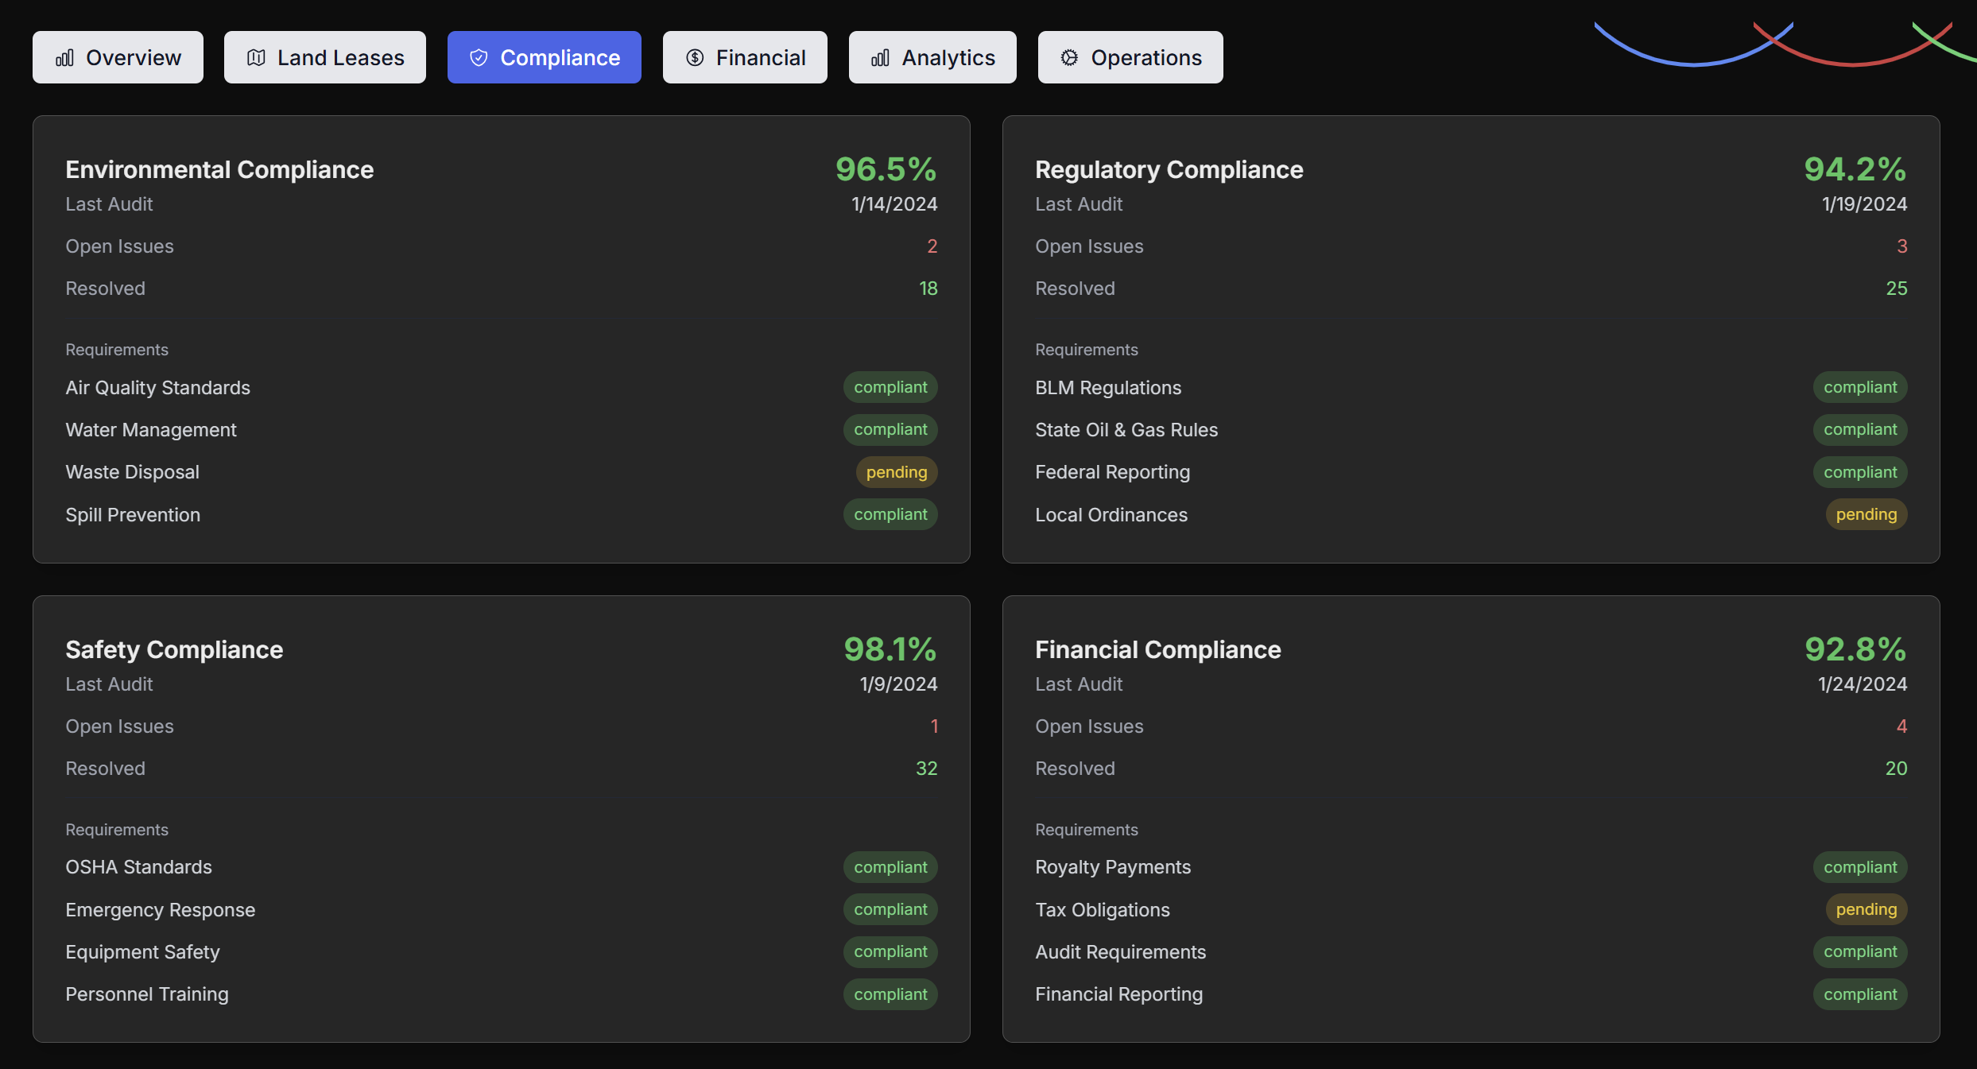
This is what compliance looks like

Slide 17
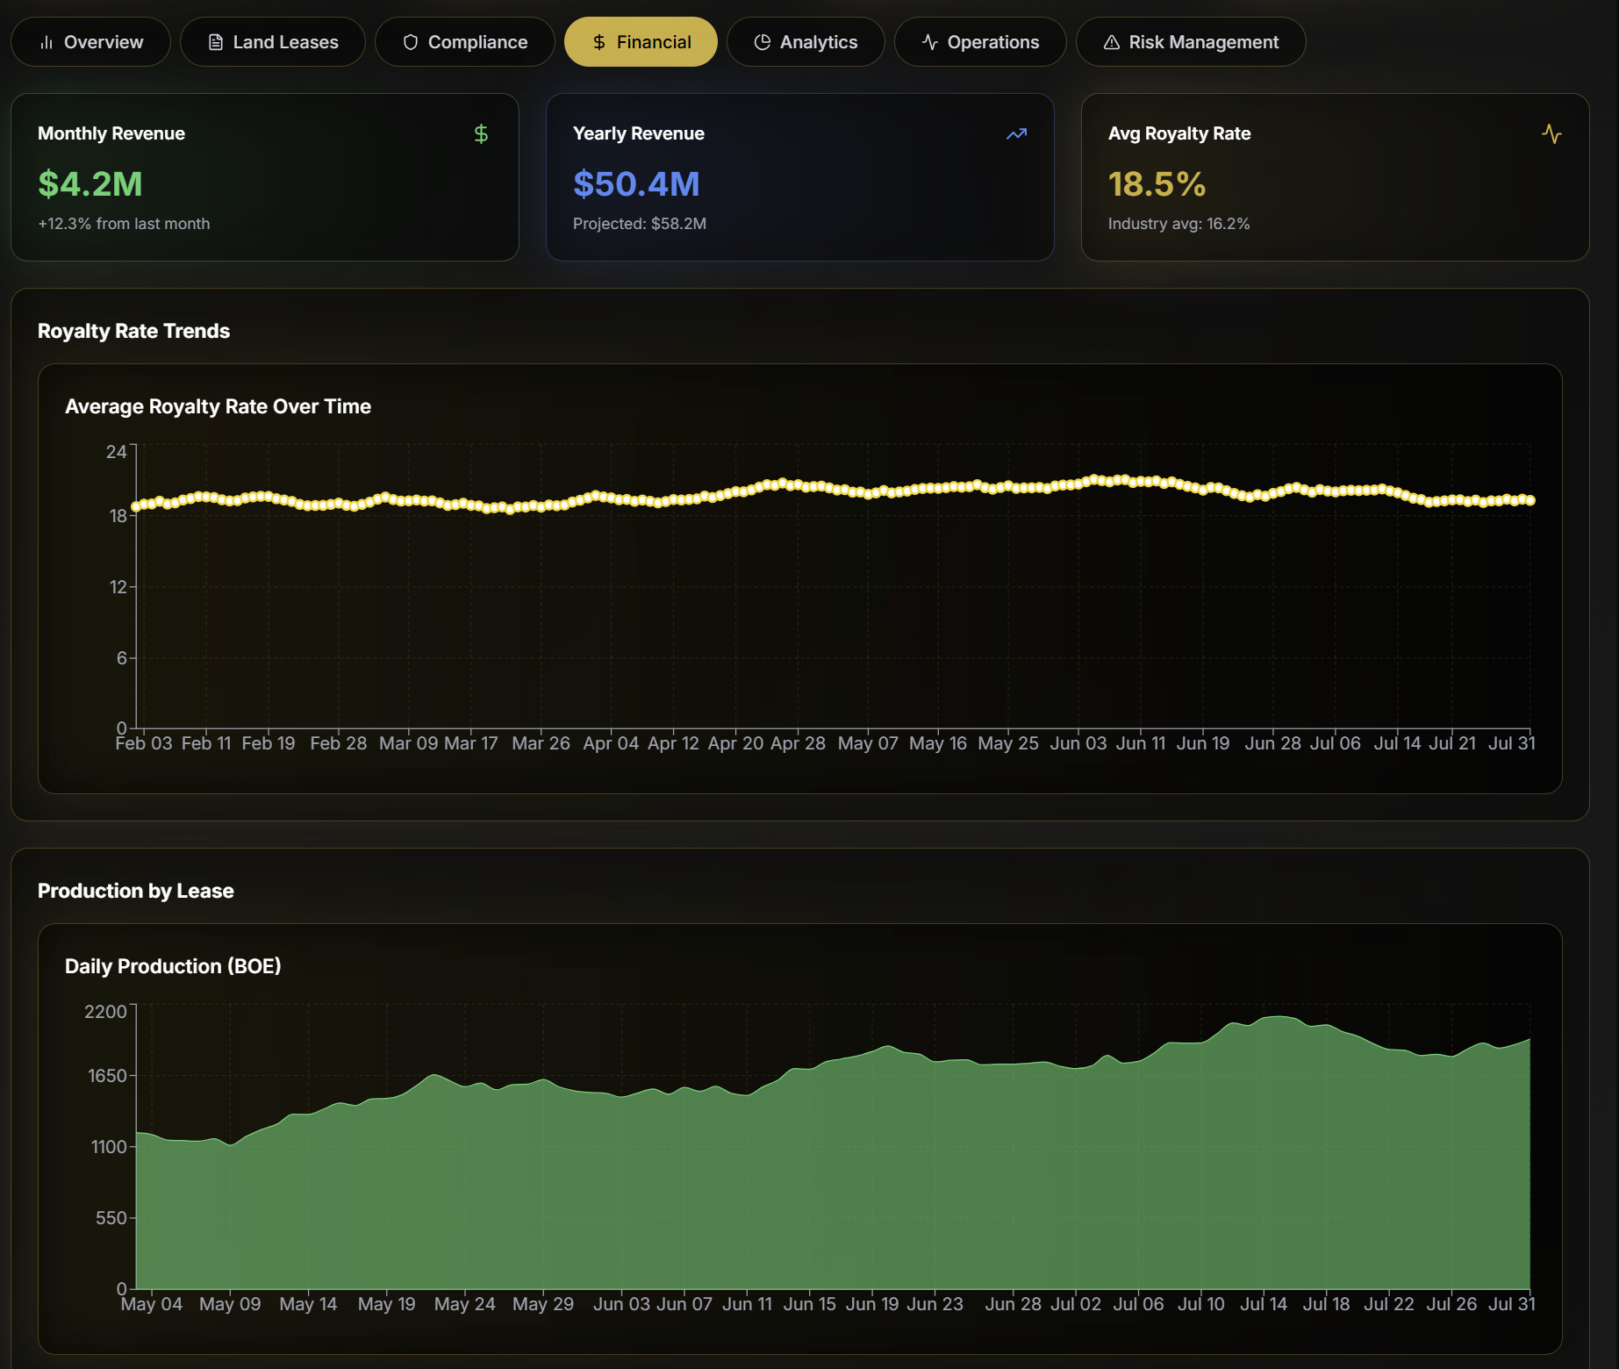
User should be able to zoom in and out of these charts – they are so high level they don’t tell any story

Slide 18
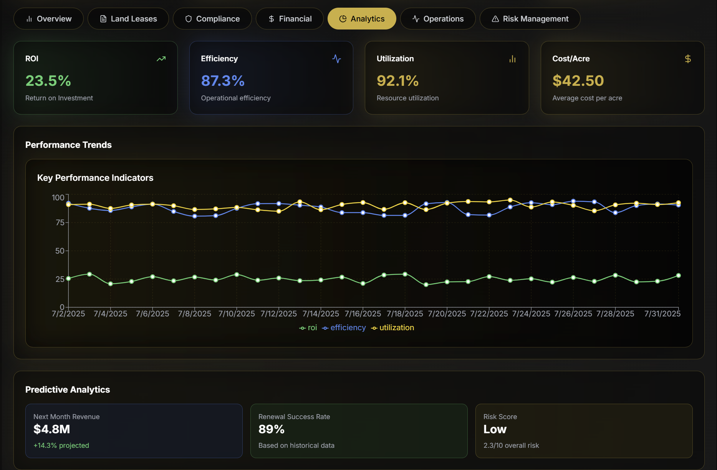

Slide 19
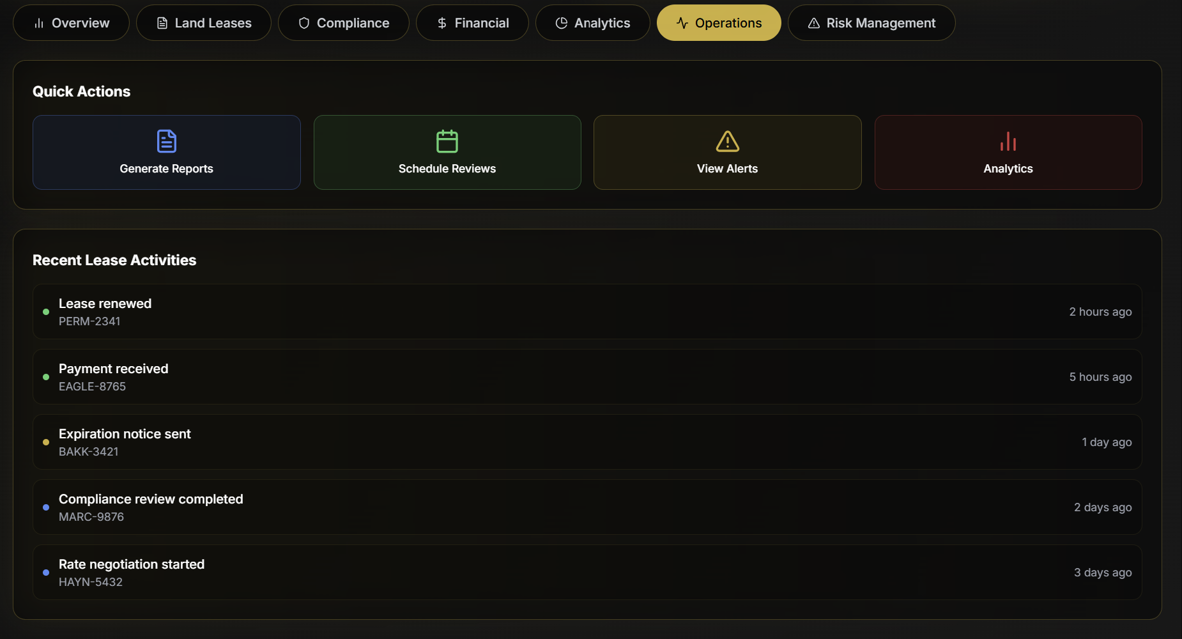

Slide 20
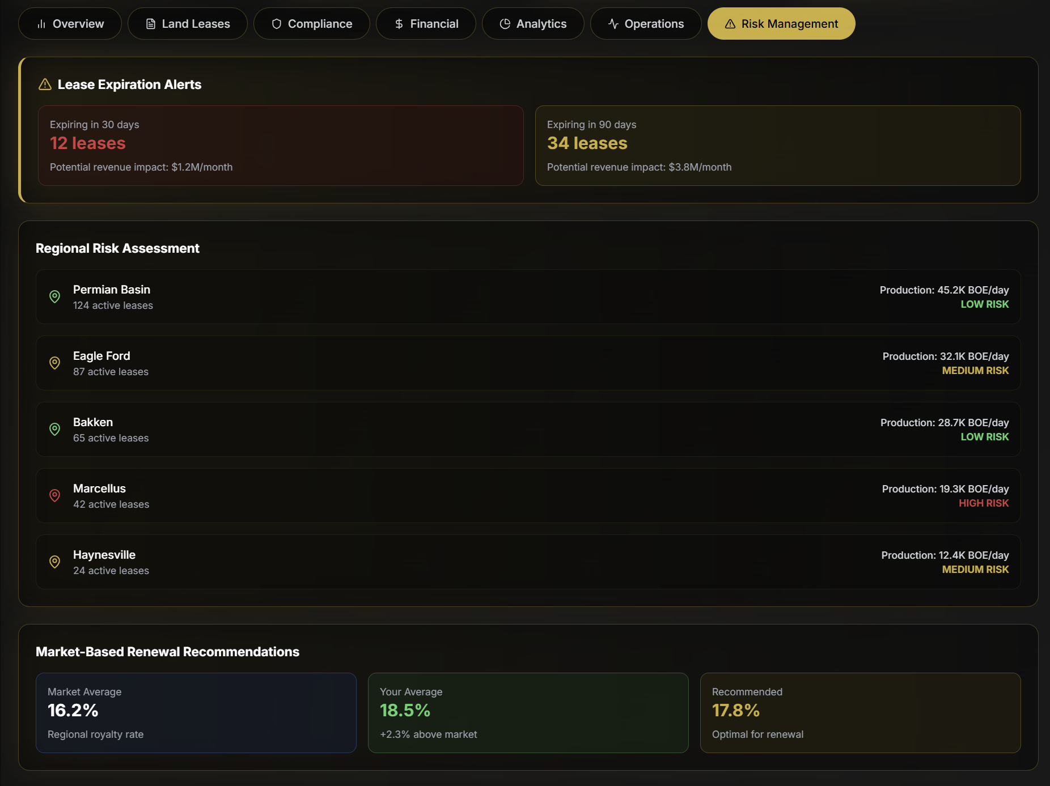

Slide 21
Certifications tab

Slide 22
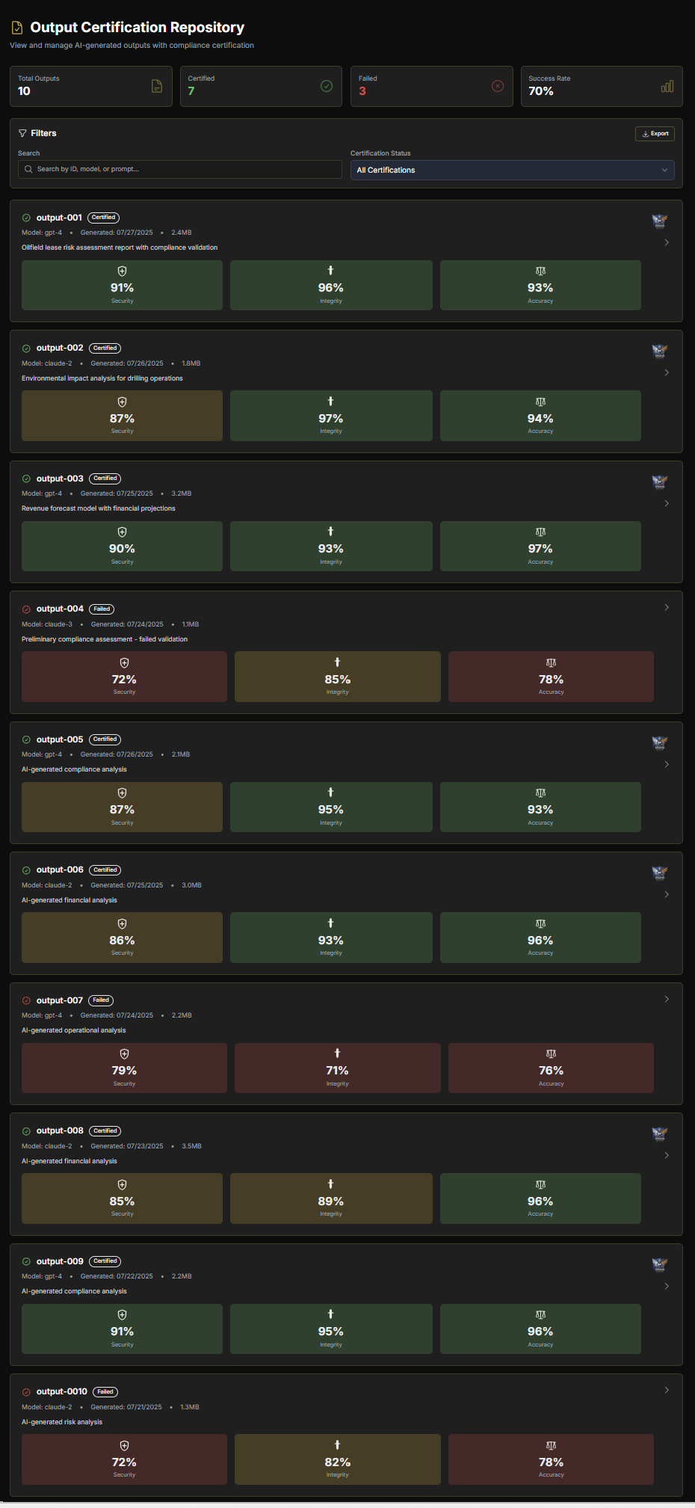
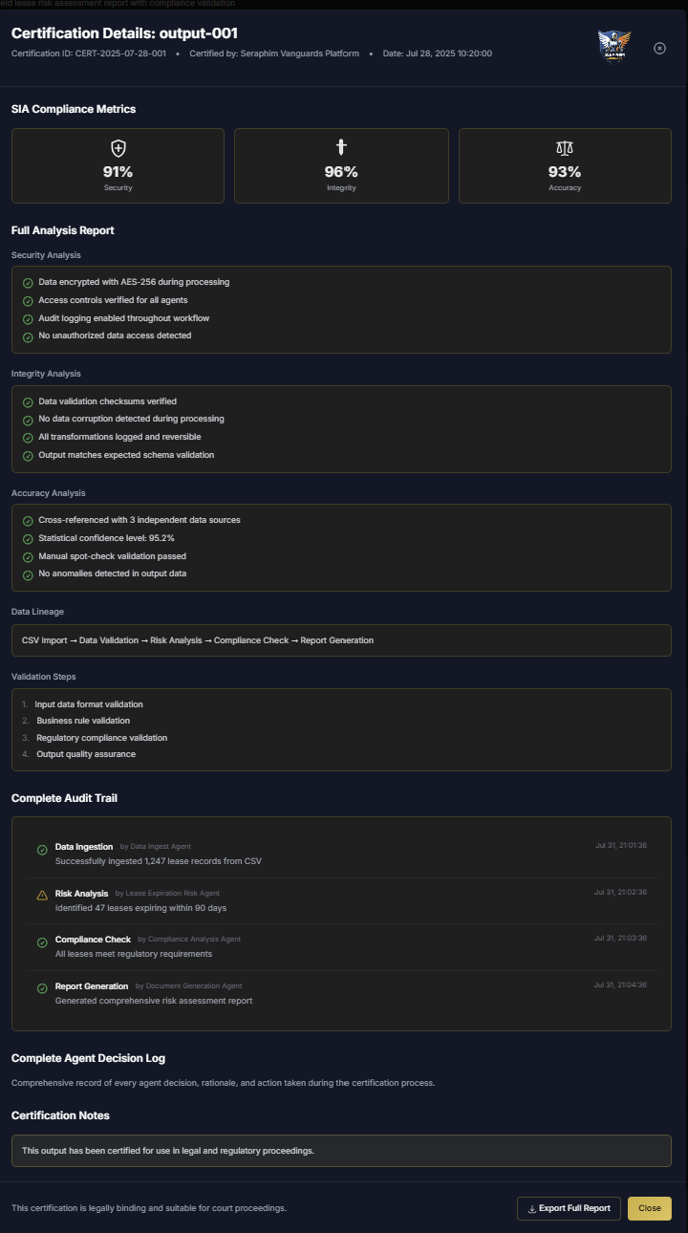

Slide 23
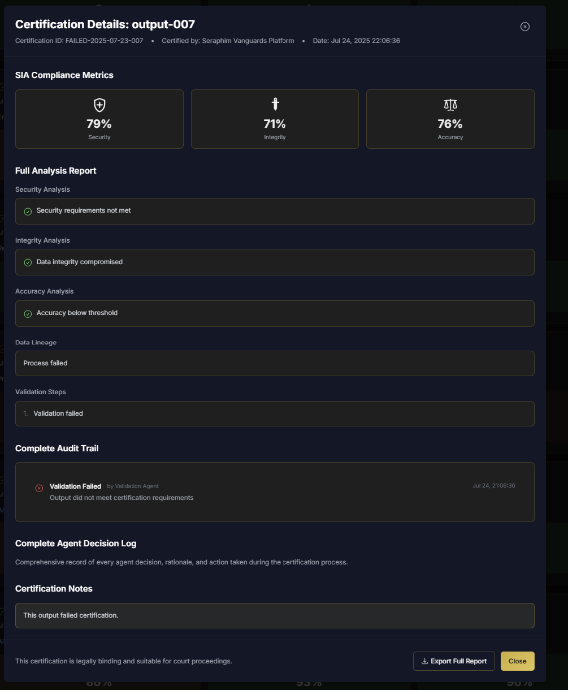
A full detailed (page length) report should be attached to Security, Integrity, and Accuracy showing why all of these things failed – using the metrics from the circular SIAs IN DEPTH as much as possible.
Data Lineage and Validation Steps should also have attached extensive reports.
Every audit decision from the audit console connected to this output should be here and the user should be able to scroll in this section and see everything.
There should be an entire log of the agents decisions, rationale, and action taken during the process – you should be able to scroll down and see them in detail here.
WE ARE NOT JUST A REPORTING DASHBOARD. The point of Vanguards is that they go back into the

